Slide 1
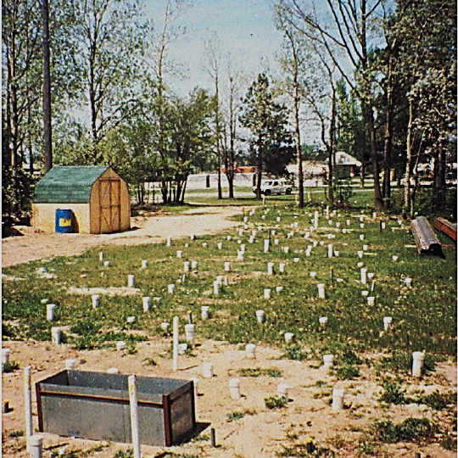
Lessons Learned from 25 Years of High-Resolution Site Characterization
Seth Pitkin
Conference on Remediation of Chlorinated and Recalcitrant Compounds – Palm Springs, 2018

Slide 2
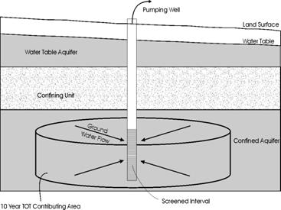
History and Development of HRSC
Aquifers are:
  Homogeneous
  Isotropic
  Infinite extent
Treated as a single bulk entity
  T
  S
  How much water can we get out of it?
Historical Perspective – Water Supply
Pumping Well
Land Surface
Water Table
Water Table Aquifer
Confining Unit
Groundwater
Flow
Confined
Aquifer
10-Year TOT Contributing Area
Screened Interval

Slide 3
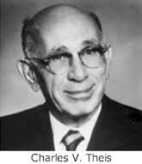

Development of (Contaminant) Hydrogeology
~130-Year Era of Homogeneity and Isotropy
John Cherry – 1981
“In the early nineteen seventies, it became apparent that … the approach used in the evaluation of contaminant migration in groundwater… involved direct adaptations of …monitoring methods and …models of the type traditionally used in groundwater resource studies. …the behavior of groundwater flow systems is … such that these direct adaptations are unsuitable or misleading because of the heterogeneous character of the geological deposits and/or the geochemical nature of the contaminant species.”
Need for
Heterogeneous
anisotropic CSMs
Recognized
Dispersion
Stanford/Waterloo
Tracer Test
HRSC Begins to
Take Hold
Darcy’s Law
Theim
Equation
CERCLA
Passed
C.V. Theis – 1967 “I consider it certain that we need a new conceptual model, containing the known heterogeneities of natural aquifers, to explain the phenomenon of transport in groundwater.”
1856
1870
1970’s
1980
1986
2004
1863
1935
1979
1981
1994
Dupuit
Equation
Thies
Equation
First Chemical
Hydrogeology
Textbook
DNAPL Paradigm
Schwille Published
Matrix diffusion
Paradigm
Key
Point
  Our science is a young one. Our thinking on solute transport is powerfully and inappropriately influenced by the first 150 years of the development of hydrogeology.
Introduction

Slide 4

Environmental Remediation: The Problem
One cannot effectively solve a problem which one has not adequately and accurately characterized (CSM)
Many Remedial Investigations continue for years or even decades
Many remedies underperform or fail due to a lack of understanding of site conditions and processes (heterogeneity)
The cost of these failed/ underperforming remedies is large
The costs of excessive long term monitoring programs related to investigating sites with monitoring wells is large
The costs of High Resolution Site Characterization, which allows one to avoid failed remedies, is small in comparison, but requires an up front investment to result in lower life cycle costs.

Slide 5
HRSC has grown along with in situ remedies
Pump & Treat
In Situ
From Superfund Remedy Report, 15th Edition - June 2017
EPA-542-R-17-001

Slide 6
mm-Scale Textural Changes
Control DNAPL Migration
Poulsen & Kueper, 1992
~25 cm
Key
Point
DNAPL distribution is controlled by capillary pressures that vary at the mm scale. Distribution is very complex.
6
Scientific Basis for HRSC
Notes:
This photograph was taken in a test pit at an experimental release site at Canadian Forces Base Borden. In this experiment by Mette Paulson (now Mette Broholm) and Bernie Kueper, two release of the same volume of PCE were staged at adjacent locations. The PCE (dyed red with Sudan IV) was released at the surface. In the first case the DNAPL was released all at once. In the second release a Marriott bottle was used to simulate a drip release over time. Once both releases had occurred and sufficient time had passed for the DNAPL to come to rest, the sites were excavated and the distribution of the PCE was mapped. In this photo, which shows approximately a 25 cm vertical section of the test pit wall, the red DNAPL can be plainly seen. The distribution of the DNAPL is controlled by subtle soil textural changes at the millimeter scale. It does not take a clay contact to direct DNAPL flow, variability in sand grain size distribution can do it.

Slide 7
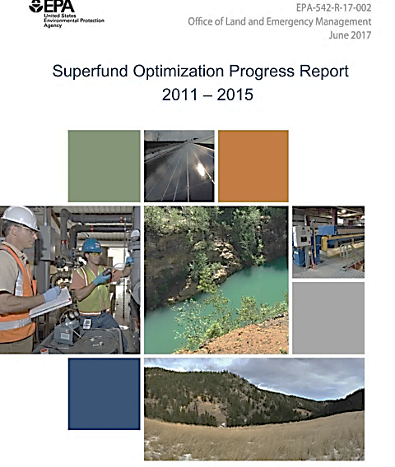
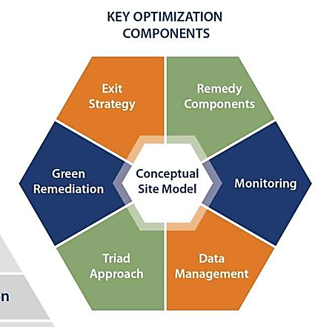
Takeaways from the Superfund Optimization Program
Recommended Tools and Techniques
Use of strategic sampling approaches
Improvements to CSM
Improved data management
Improved system engineering
Change in remedial approach
Use of combined remedies
Streamlined or improved monitoring

Slide 8
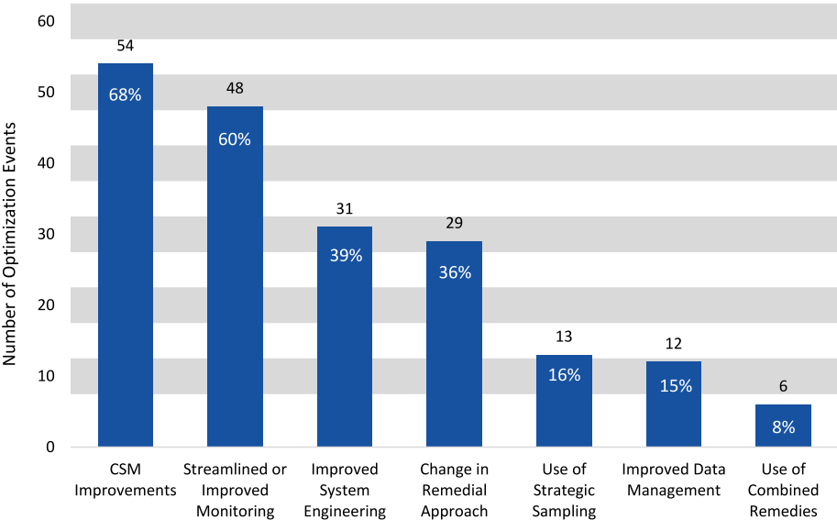
What Are We Getting Wrong?
From Superfund Optimization Progress Report- June 2017

Slide 9
Data Needs: What you need to know
What phases are the contaminants in? (NAPL, aqueous, sorbed, gas)
What is the source? (NAPL, sorbed mass, solute mass in low K zones)
Where is the source located in 3 dimensions
Where is the source located w.r.t. permeability? (in high K zones or low K zones)
Where are the primary transport pathways?
Where are the receptors?
What attenuation mechanisms are active? (sorption/retardation, biodegradation, abiotic degradation, dispersion, diffusion into low K zones)
For most sites these questions can only be answered using High Resolution Site Characterization

Slide 10
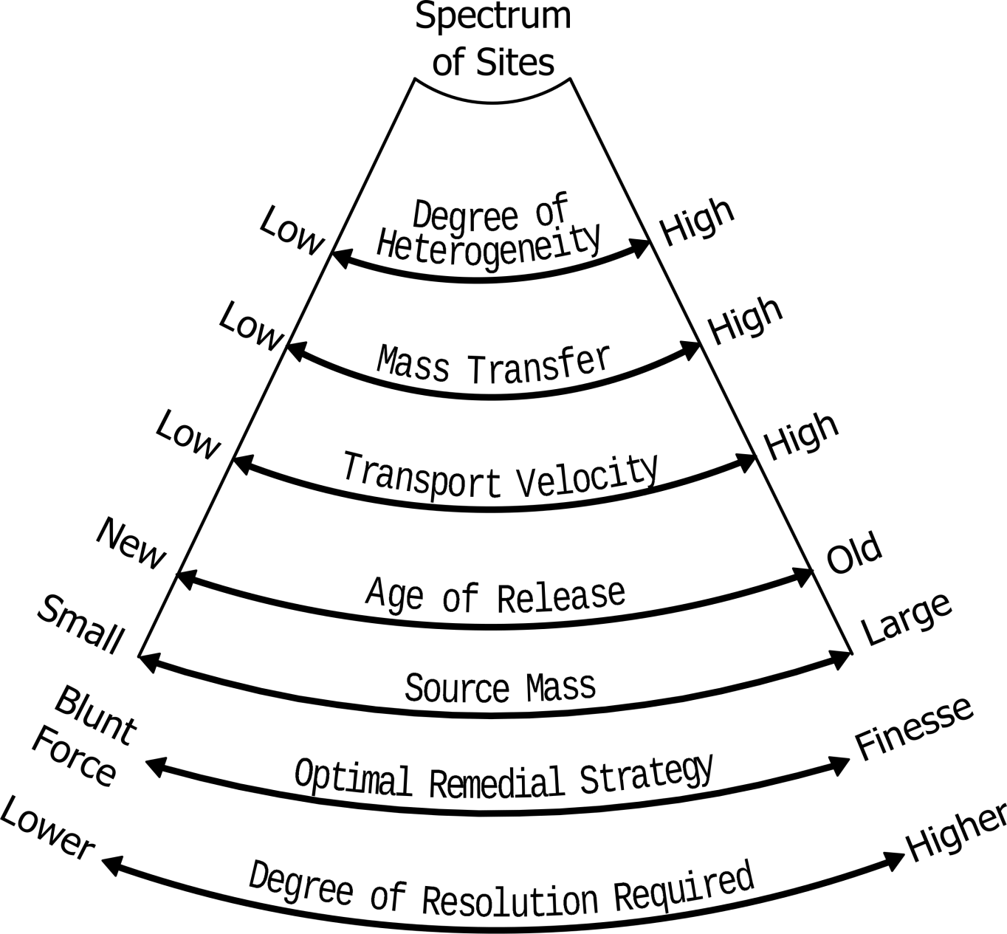
Site Complexity, Data Needs and Technological Sophistication
“Simple”
Complex
Adapted from Fred Payne – ARCADIS

Slide 11
HRSC is More than Just Tools
Incorporation of major paradigms into CSM (e.g.)
  Heterogeneity and Anisotropy
  Awareness of spatial structures of key variables
  DNAPL
  Weak Transverse Dispersion
  Matrix diffusion/back diffusion
  Incorporation of geologic interpretation (e.g.,sequence stratigraphy) in CSMs to provide framework for flow systems
Collaborative use of tools
  Direct sensing for screening, NAPL detection (LIF, not MIP)
  Groundwater/hydrostratigraphy profiling in permeable zones
  Soil coring and sub core profiling for aquitard/low K material
  On site analytical chemistry
Transects
Incorporation of the Triad Approach principles
  Dynamic work Strategies
  Real-time data
  Collaborative Data

Slide 12
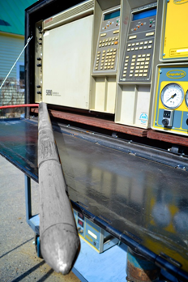
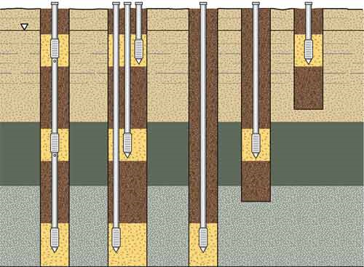
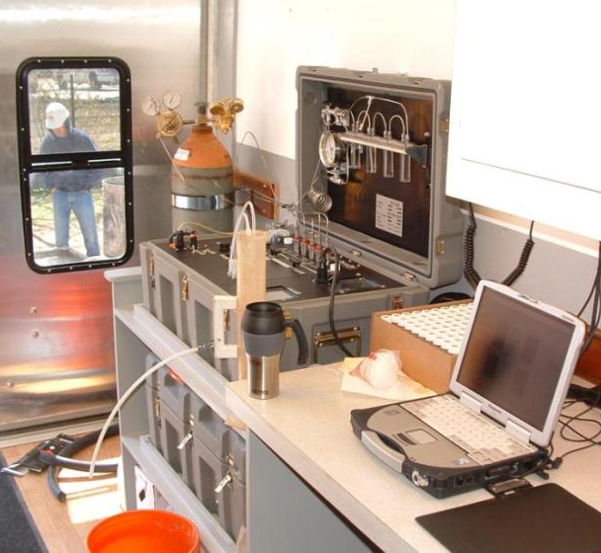

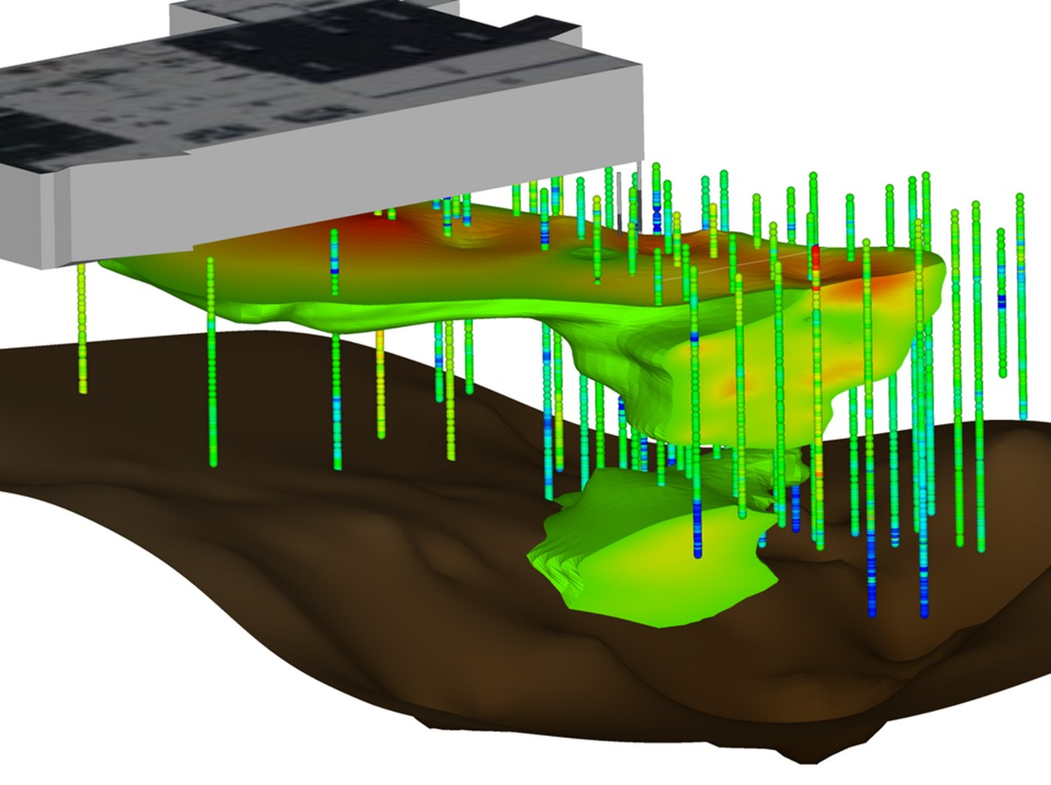
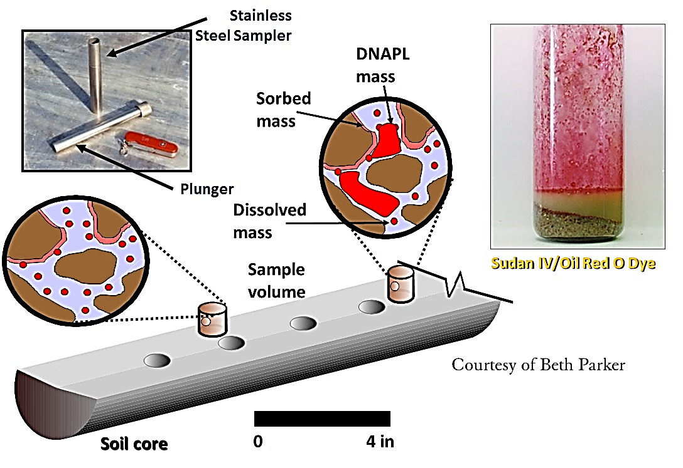
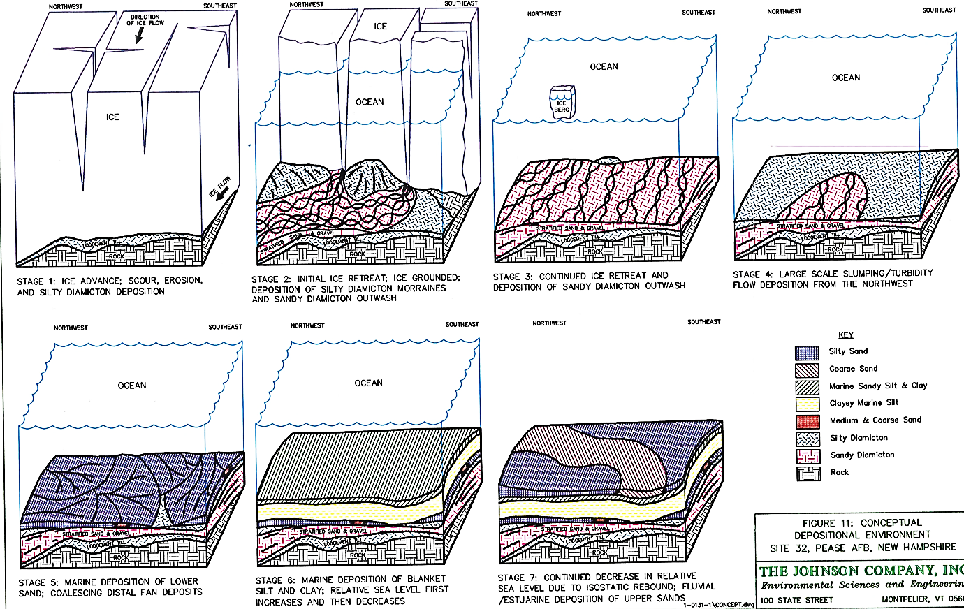
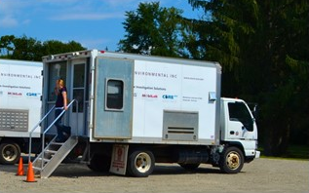
Multilevel Monitoring
Definitive Vertical Profiling and Injection logging
Screening methods
Saturated Soil Core Profiling
Mass Flux Assessment
Onsite Analytical Chemistry
Geological Depositional Model

Slide 13
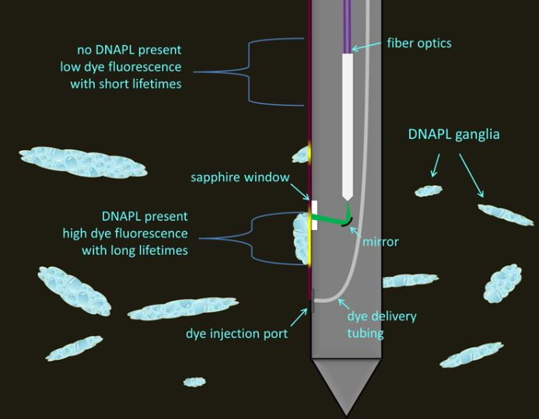
Commonly Used Tools
Direct Sensing
  MIP, MiHPT, low level MIP (screening)
  NAPL Fluoresence Probes
    LIF
      UVOST (aromatic compound NAPLs Fuels)
      TarGOST (polyaromatic compound NAPLs Coal tar, creosote)
      Dye-LIF (Chlorinated NAPLs PCE TCE etc)
    Geoprobe – Optical Interface Probe (OIP)
  Injection Logging (HPT, Waterloo^{APS})
Definitive Tools
  Waterloo^{APS} with I_{K}
  HPT-GW
  On Site Laboratory
  High Res. Soil Core Profiling in Aquitard Materials
High Resolution Piezocone (K values)
CPT (inferred Stratigraphy)
Coming Soon?
  Nuclear Magnetic Resonance?

Slide 14
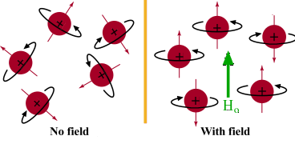
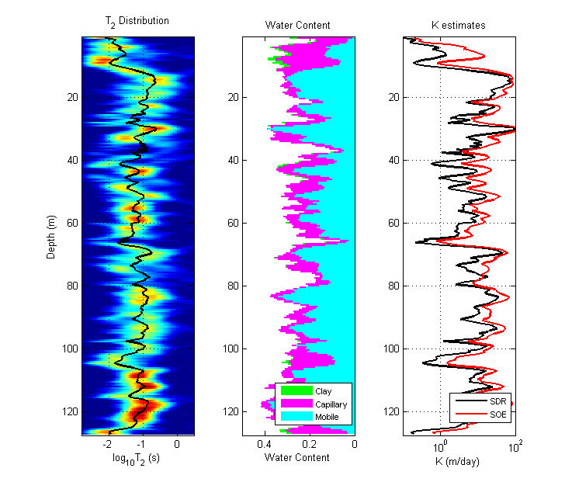
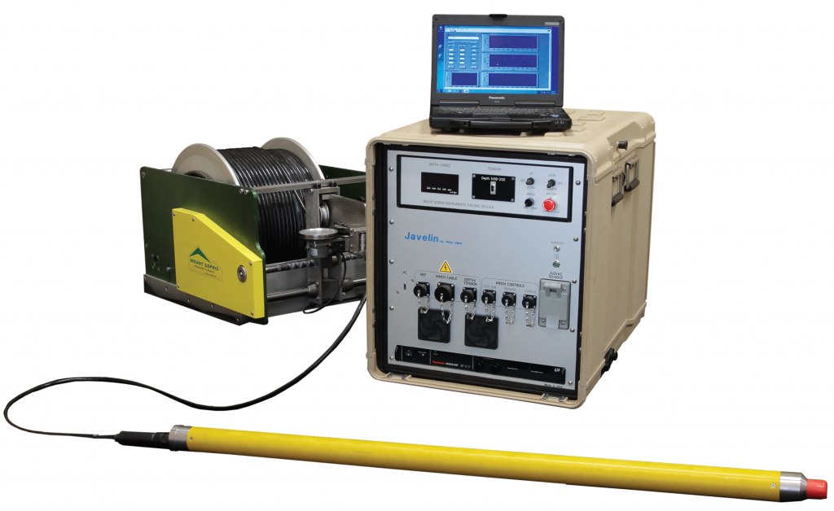
Nuclear Magnetic Resonance?
Detection and quantification of hydrocarbons
Precise determination of porosity and water content
Estimation of permeability, mobile/bound water fraction, pore-size distributions
Sensitivity to geometric and geochemical pore-scale properties

Slide 15
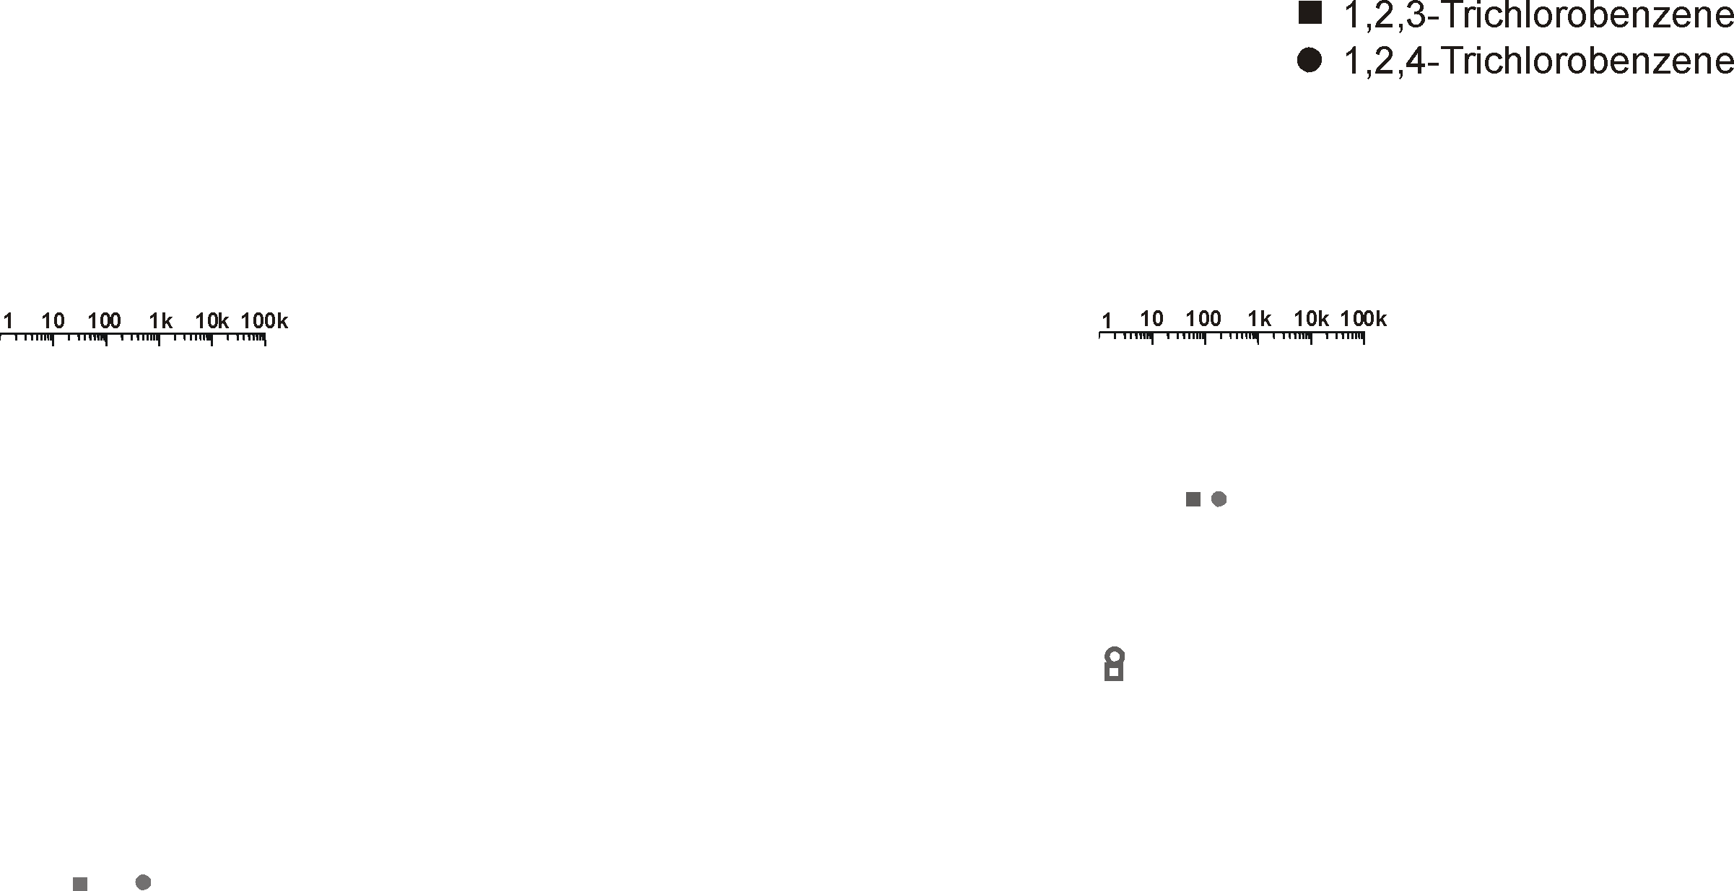
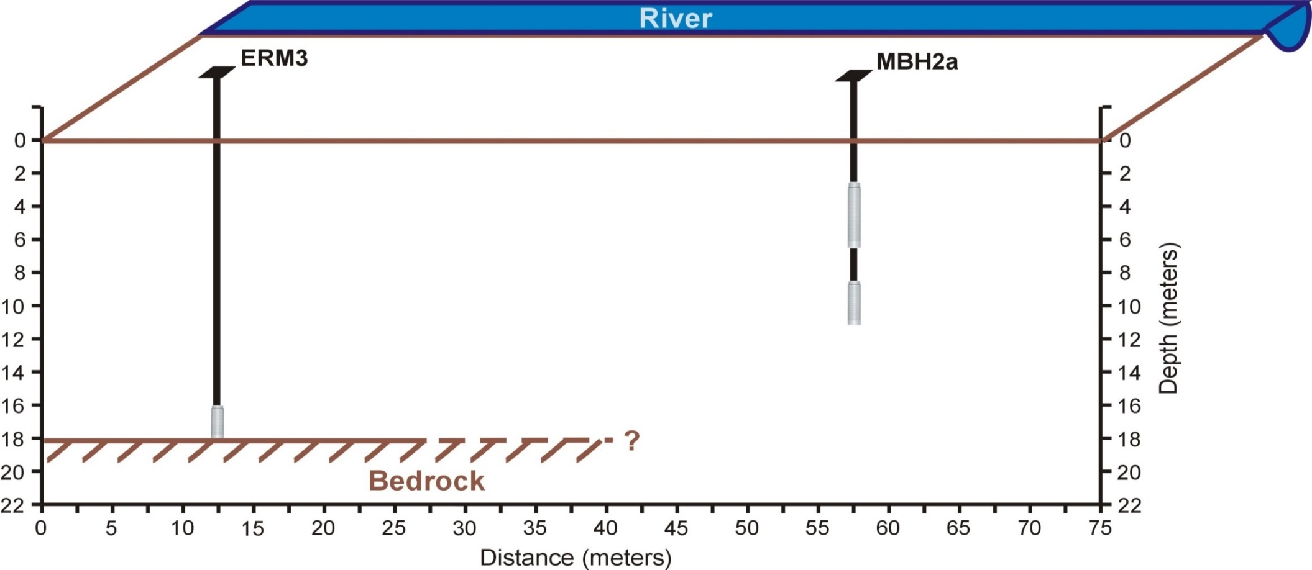
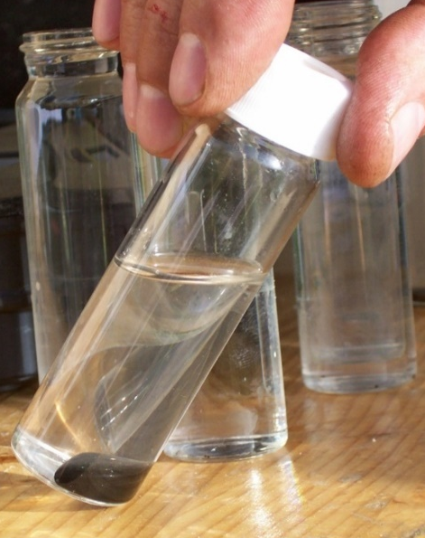
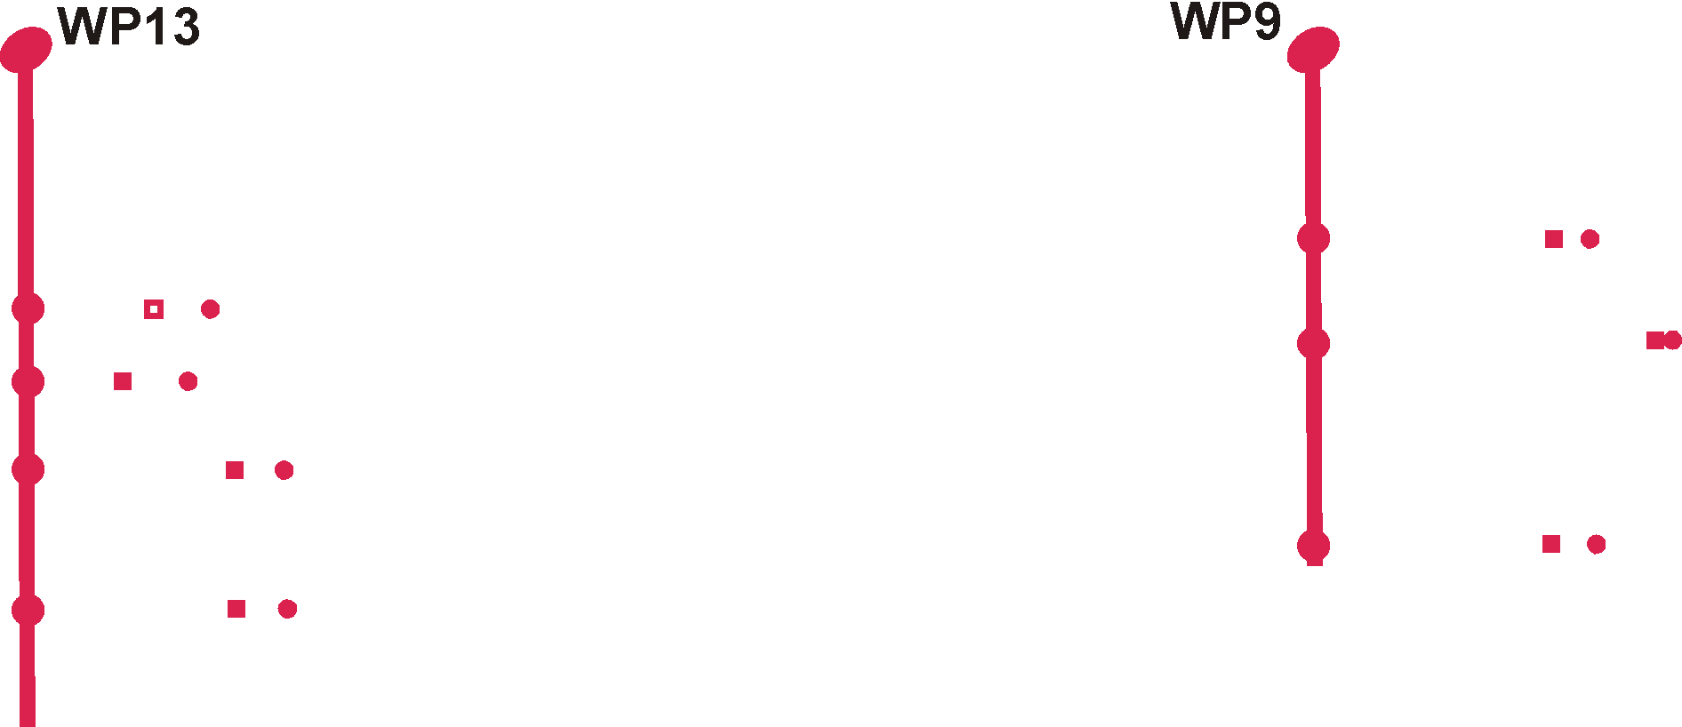
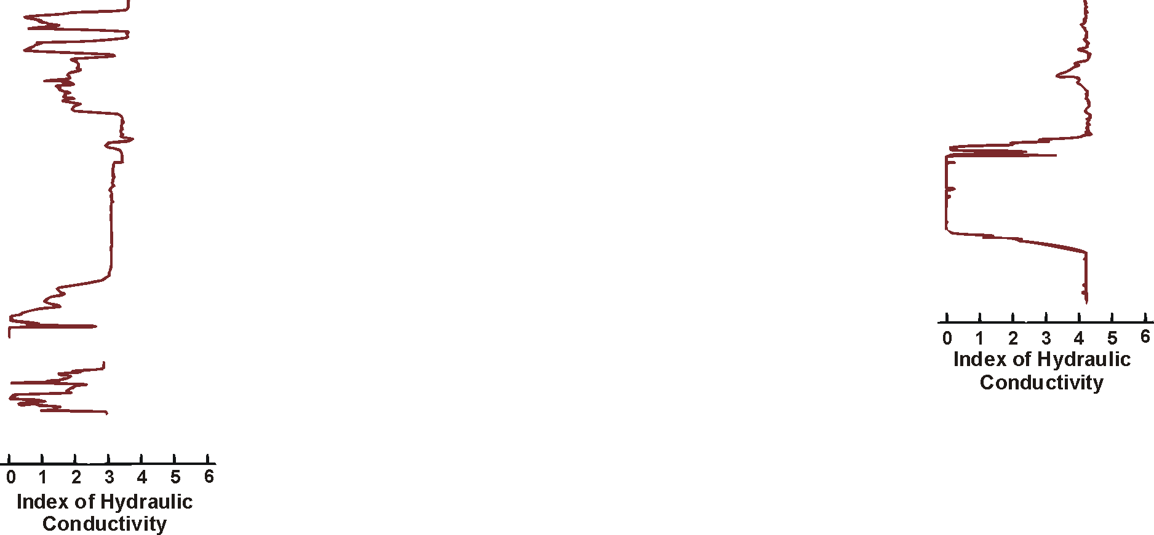

Post-Remedy Investigation Northern England

Slide 16
Estimated Relative Mass Flux Distribution on Waterloo^{APS} Transects
Simplified relative flux estimate:
  Convert I_{K} to assumed/estimated K_{est} values
    In this case assume - K_{est} (cm/sec) = 8E-07e^{1.9702 IK}
  Assume variability of i is negligible and assume unit area of 1 cm²
  Interpolate K_{est} in 3D and Concentration in 3D; Then multiply the 3D meshes against each other to get 3D flux field in ug/sec/cm²
  Estimated relative flux values resulting are:
    Screening Level
    Relative (as opposed to the absolute values obtained by passive flux meters, integrated pumping tests etc)

Slide 17
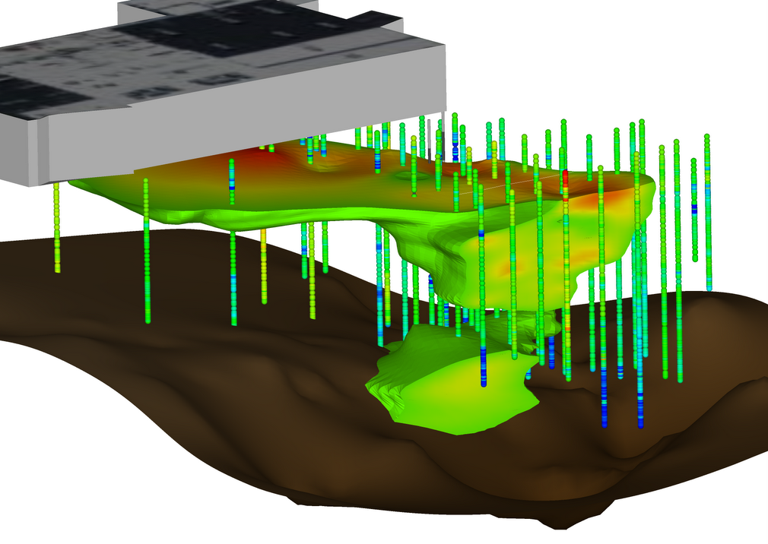
10 mg/L TVOC Isoshell
Bedrock Surface
Index of Hydraulic Conductivity Color log

Slide 18
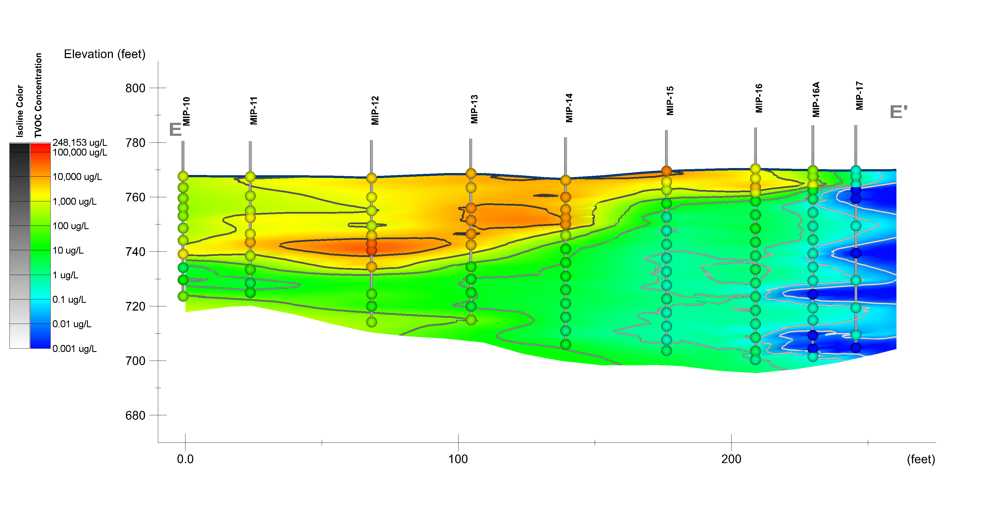
Transect E – TVOC Concentration
High Concentration Zones (>10,000 ug/L)

Slide 19
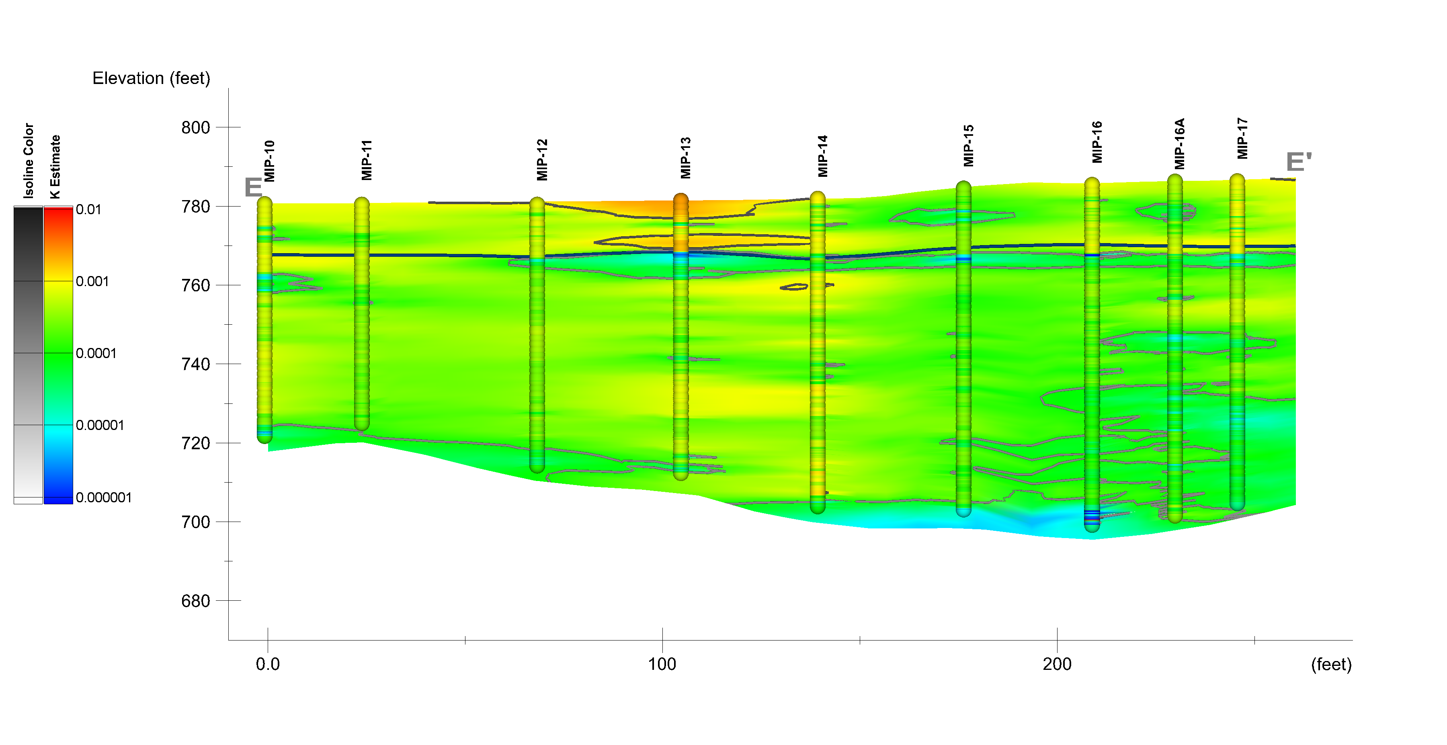
Transect E – Estimated Hydraulic Conductivity
High K Zones
Vadose Zone
High Concentration Zones

Slide 20
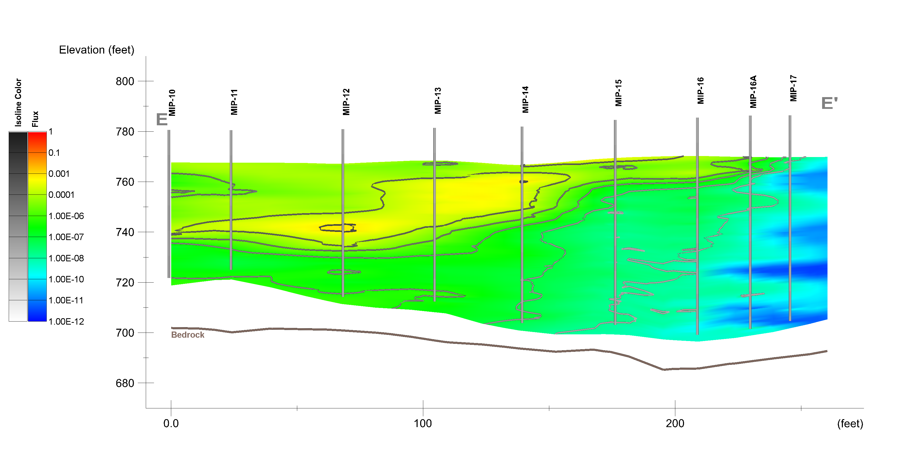
Transect E – Relative Mass Flux Distribution
12% of mass discharge across 0.2% of cross sectional area
High Concentration Zones
74% of mass discharge across 13% of cross sectional area

Slide 21
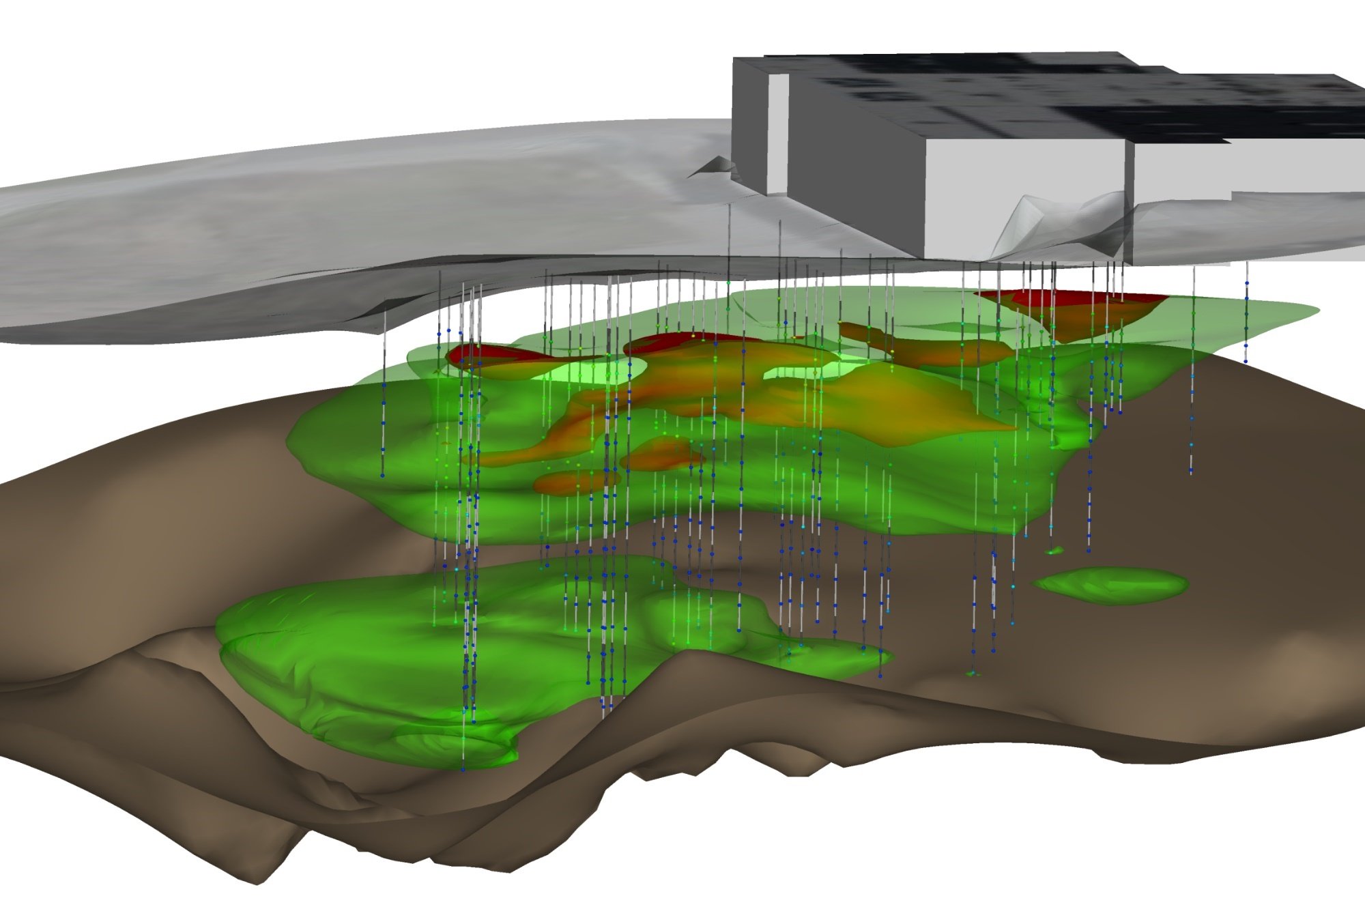
Mass Flux Relative to Plume Volume
70% of the mass discharge occurs across approximately 6% of the cross sectional area of the plume
50 ug/L isoshell
95% of Mass Flux

Slide 22
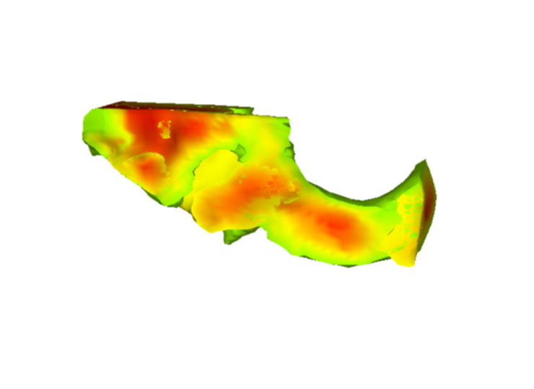
High Resolution Site Characterization:
The Bottom Line
STEAM
EVO
EVO
“…instead of treating a more conventional rectangle, the density and quality of the data allowed for us to isolate the contaminant zones to a smaller and more irregular shaped region of the site.”
“We were able to confidently reduce the treatment area by about 40%”
“The result was a more focused and more efficient remediation strategy.”

