Slide 1



High-Resolution Delineation of Chlorinated Solvent Concentrations, Biogeochemical Processes, and Microbial Communities in Saturated Subsurface Environments
Haley Schneider
Texas Tech University
Battelle Chlorinated Solvents Conference
April 11, 2018

Slide 2
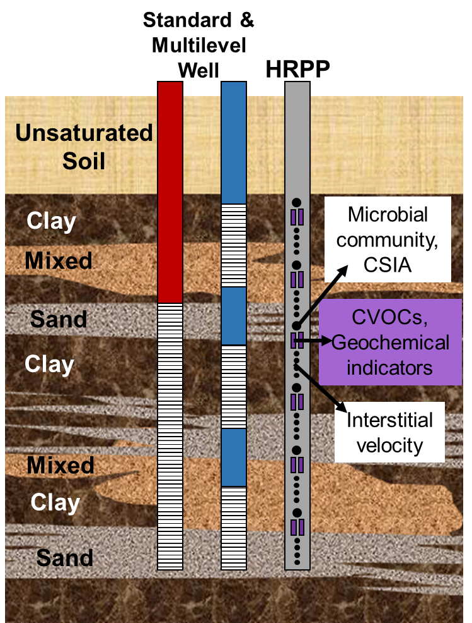
Research Objectives
Develop and demonstrate a High Resolution Passive Profiler (HRPP) as a fine-scale delineation tool for the saturated subsurface
    At cm-scale resolution:
    Directly measure groundwater and contaminant flux
    Quantify geochemical conditions
    Assess microbial community structure and activity
Standard
Multilevel
HRPP
Depth
Concentration
Notes:
The SERDP Program Manager will have introduced the statement of need that you are addressing and will have introduced your specific project to the SAB. What you should do on this slide is briefly describe what specific aspect of the stated problem that you are addressing. A mixture of graphics, cartoons, and words is appropriate here.
Number of Slides: 1
Time: 1 minute

Slide 3
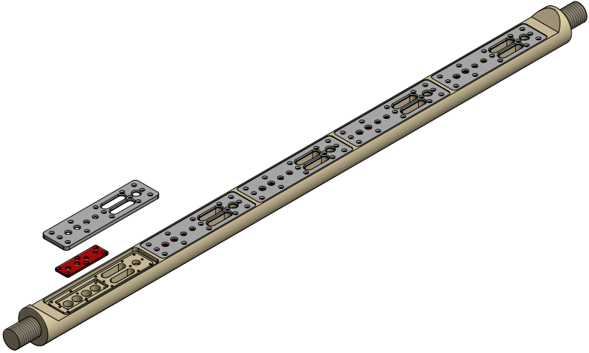
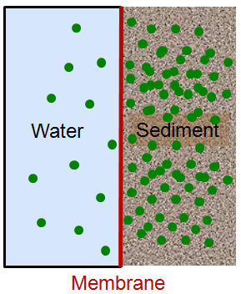

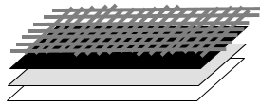
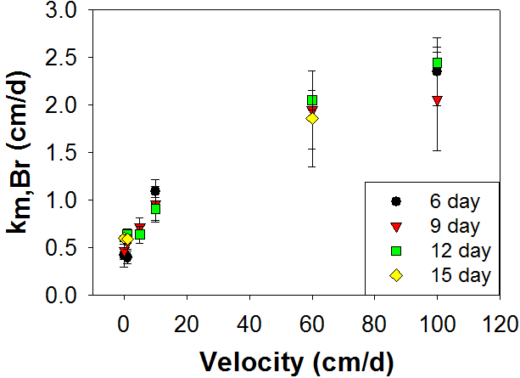
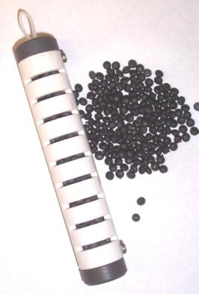
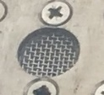
HRPP Functionality
Steel Mesh
Viton
Nylon Mesh
Membrane
Bio-sep beads
(pictured with standard biotrap)
Microbes attach to beads
Quant Array Analysis
Compound Specific Isotope Analysis
Fill HRPP cell with bio-sep beads
Contaminants adsorb to beads

Slide 4


Equilibrium Porewater Sampling
Equilibrium Cells
~3 weeks (tunable)
Any soluble species
TCE
Cl
PCE
TeCA
PO₄
Sampler Cell
SO₄
TeCA
TCE
Cl
PO₄
PCE
SO₄
Membrane

Slide 5
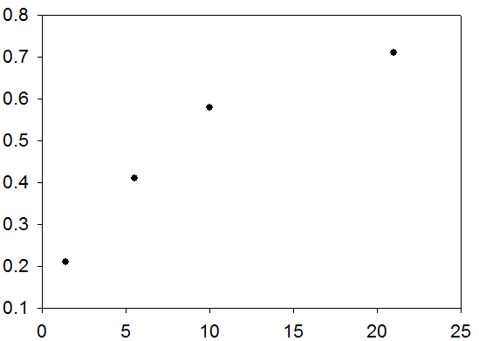

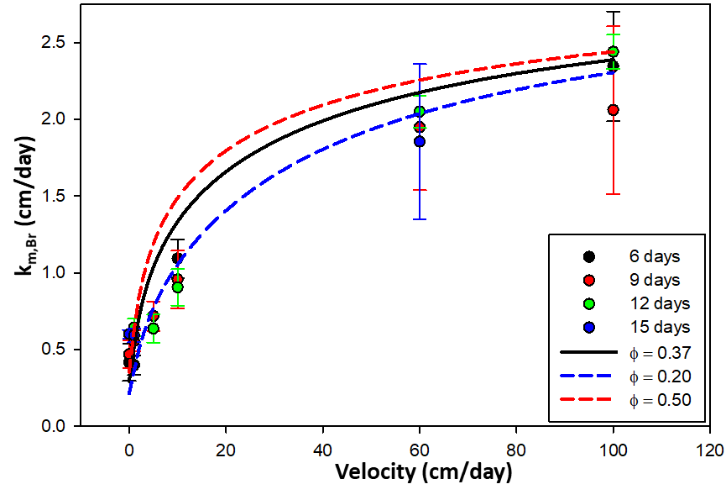
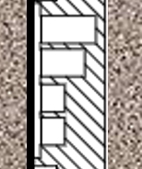
Estimating Groundwater Velocity
Plot C/Co vs. V/A and fit equation for k_{m}
Measure Br- concentration after HRPP is extracted
C/Co
V/A (cm)
Br-
Br-
k_{m,Br} (cm/day)
Br-
Br-
Br-
Br-
Velocity (cm/day)

Slide 6
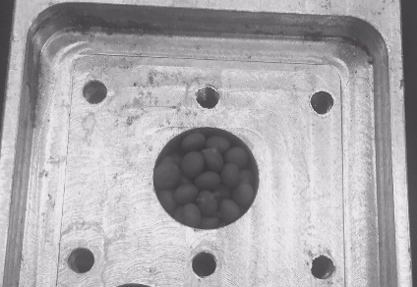
Microbial Community and Compound Specific Isotope Analysis
Bio-sep beads
(pictured with standard biotrap)
Microbes attach to beads
Quant Array Analysis:
Detection of microbial communities and degradative genes
Compound Specific Isotope Analysis:
Contaminant source, potential for degradation, extent of current degradation
Contaminants adsorb to beads

Slide 7
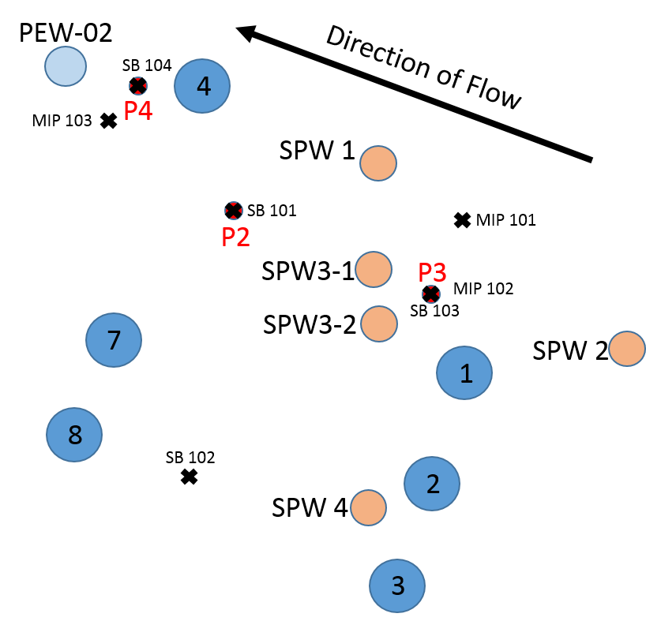
Field Deployment of HRPP
Naval Air Station – Alameda, CA
Test HRPP for:
  Direct push insertion into shallow aquifer (~20 feet below ground surface)
  Delineation of groundwater velocity, VOCs, microbial communities, and CSIA compared to monitoring wells, soil cores, and membrane interface probe (MIP) data
Multilevel Well
Scale in Feet
Standard Well
0
3
6
HRPP
MIP / Core

Slide 8
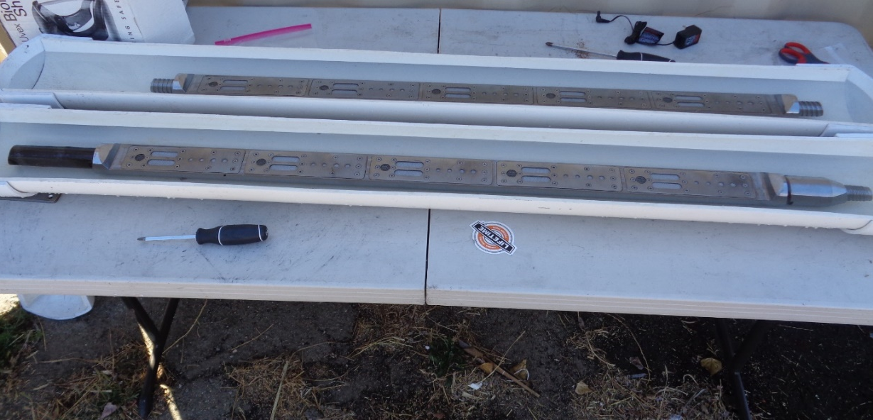
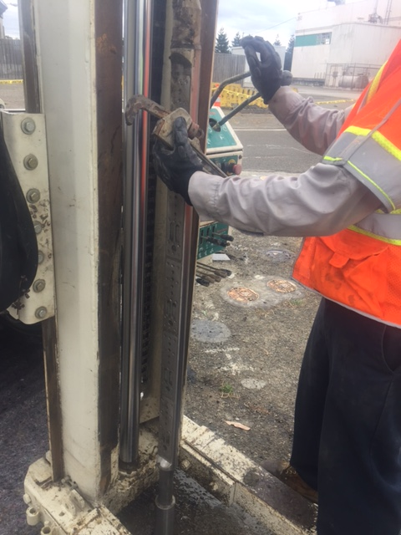
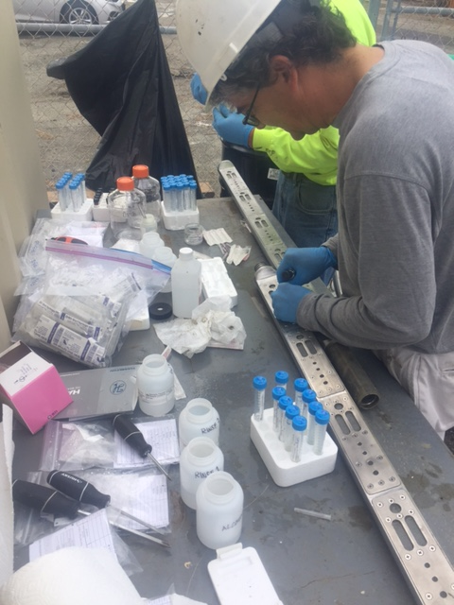
Field Deployment of HRPP
Preparation
Insertion
Sampling

Slide 9
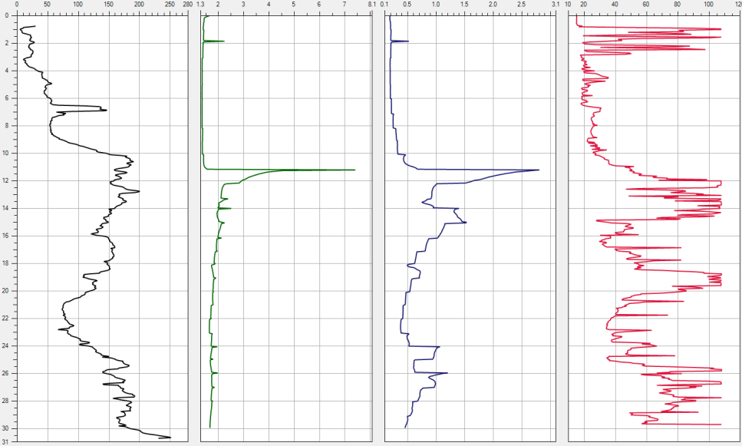
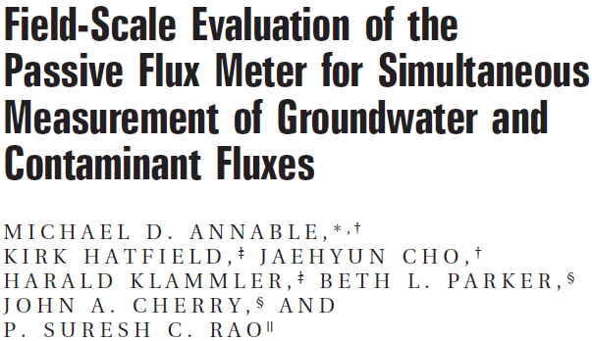
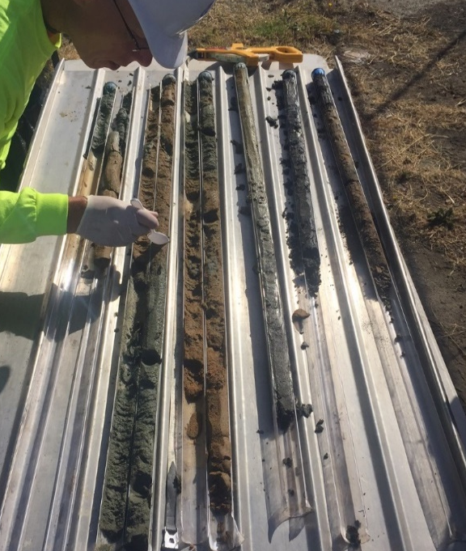
Comparative Data Sets
Membrane Interface Probe
Passive Flux Meter
Depth (ft)
EC (mS/m)
ECD (uVx10⁶)
PID (uVx10⁶)
HPT (psi)
Soil Cores
Multilevel Wells
C. Schaefer

Slide 10
P3 and Surrounding Area
Naval Air Station – Alameda, CA
Multilevel Well
Standard Well
HRPP
MIP / Core

Slide 11
P4 and Surrounding Area
Naval Air Station – Alameda, CA
Multilevel Well
Standard Well
HRPP
MIP / Core

Slide 12
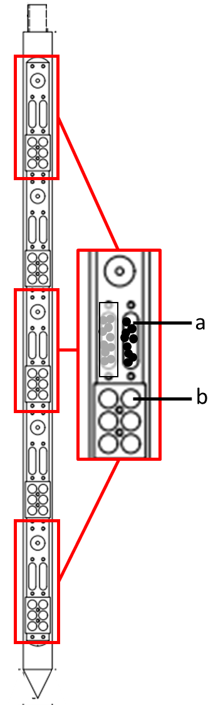
Effects of microbial colonization of Bio-Sep beads on CSIA
Membrane prevented bacterial colonization
Modified assembly of P2
Reductive dechlorinating gene | Concentration (cells/bead) with membrane | Concentration (cells/bead) without membrane
Dehalococcoides spp. | - | 208
TCE reductase | - | 74
BAV 1 vinyl chloride reductase | - | 31
Vinyl chloride reductase | - | 7
Desulfitobacterium spp. | - | 1,110
Desulfuromonas spp. | 880 | 188,000
Equilibrium cells:
filled with Bio-sep beads
One covered with membrane
Velocity cells:
one cell used for CVOC concentrations
Remaining 5 for velocity
CSIA results are not affected
CVOC | δ¹³C (membrane) | δ¹³C (no membrane)
vinyl chloride | -31.9 | -28.8
cis-DCE | -22.4 | -20.3
TCE | -18.2 | -20.8

Slide 13
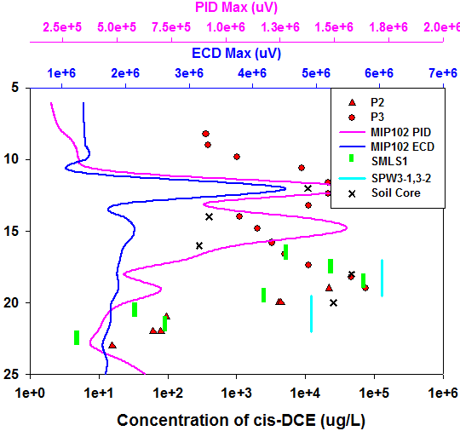
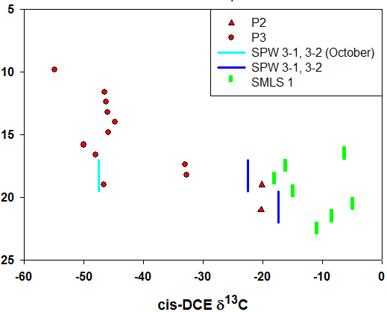
cis-1,2-Dichloroethylene
Concentrations & CSIA
Depth below ground surface (feet)
PID – photoionization detector
ECD – electron capture detector

Slide 14
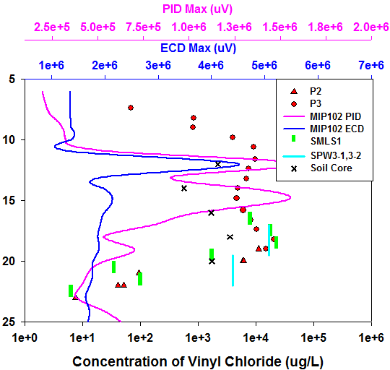
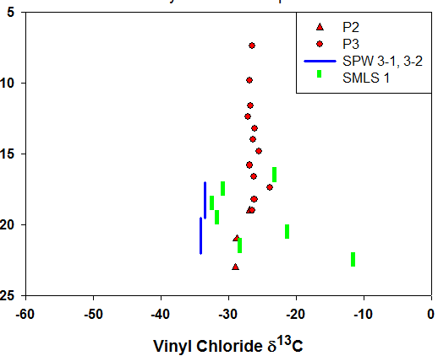
Vinyl Chloride
Concentrations & CSIA
Depth below ground surface (feet)
PID – photoionization detector
ECD – electron capture detector

Slide 15
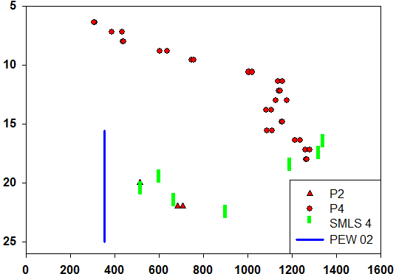
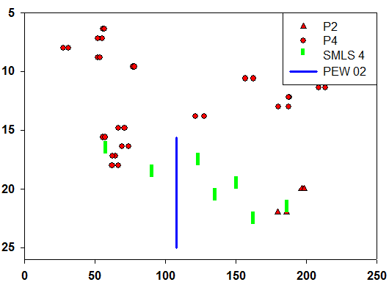
Geochemistry
Chloride, Sulfate
Other possible groundwater constituents:
NO₃⁻, NO₂⁻, Fe_{T}, Fe⁺², DOC
Depth BGS (feet)
Depth BGS (feet)
Chloride (mg/L)
Sulfate (mg/L)

Slide 16
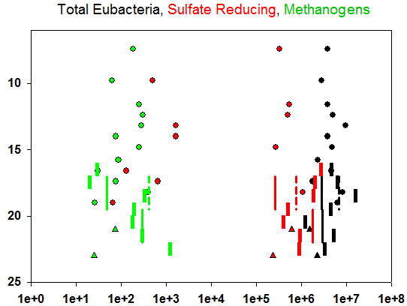
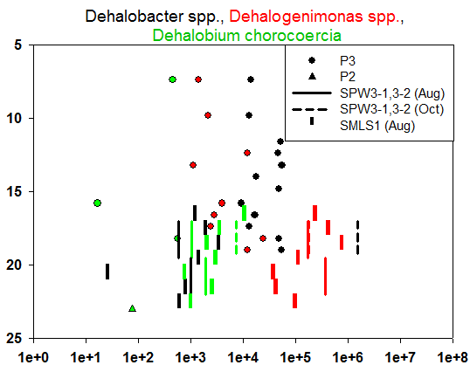
Microbial Communities
Depth below ground surface (feet)
Cells/bead (cells/mL August samples)
Cells/bead (cells/mL August samples)
Other Possible Data:
DHC DSM RDEG VCR TOD EtnE DCM PHE DCMA DSB TCBO TCE SMMO RMO BVC PMMO EtnC

Slide 17
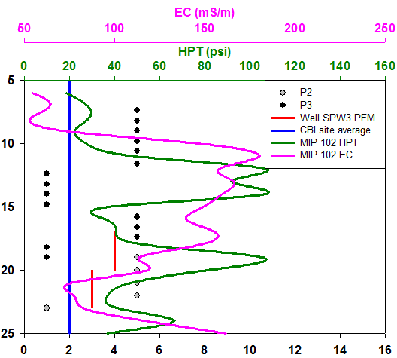
Groundwater Velocity Estimates
EC – electrical conductivity
HPT – hydraulic profiling tool
Depth BGS (feet)
Estimated velocity (cm/d)

Slide 18
Importance of Work
High resolution data without well installation
  Better site modeling
  Insight into remediation design
    Natural attenuation potential
    Need for bioaugmentation
  Monitor remedial activities
    Distribution of amendments
    Bacterial community/capacity
  Determine impact of low permeability zones
    Potential for rebound
    Well placement

Slide 19

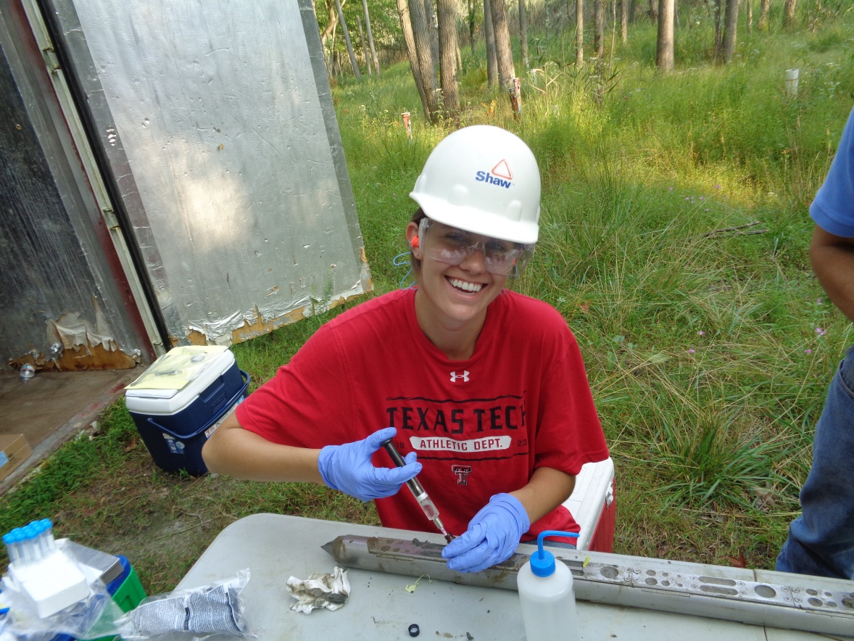

Acknowledgements
Paul Hatzinger
Paul Koster Van Groos
Mark Tucker
SERDP ER-2419
W. Andrew Jackson
Stephen Morse
Danny Reible
Henry Yew

Slide 20

Questions ?
For additional information, please visit https://www.serdp-estcp.org/Program-Areas/Environmental-Restoration/Contaminated-Groundwater/Persistent-Contamination/ER-2419
Speaker Contact Information
haley.a.schneider@ttu.edu

Slide 21
Supporting Information
Velocity Laboratory Experiments

Slide 22


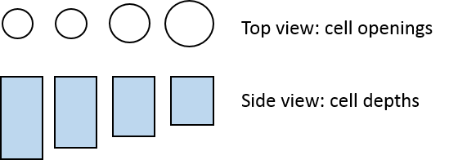
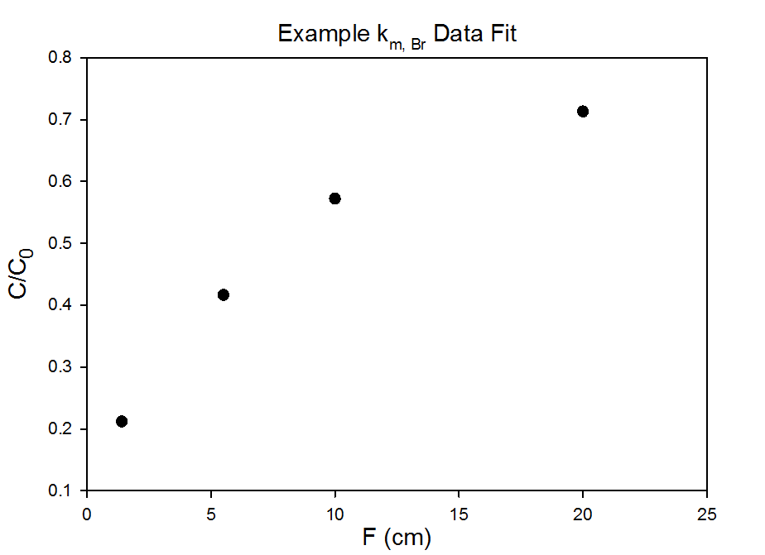


HRPP Velocity Cell Design and Rationale
Key Point:
Use multiple F factors to create a data curve from a single time point
C = measured tracer concentration at t
C₀ = initial tracer concentration
t = time C is measured
k_{m} = unknown
Plot C/Co vs. F and fit equation for k_{m}
F1
F2
F3
F4

Slide 23
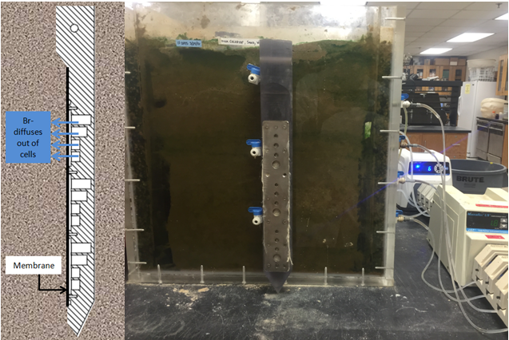
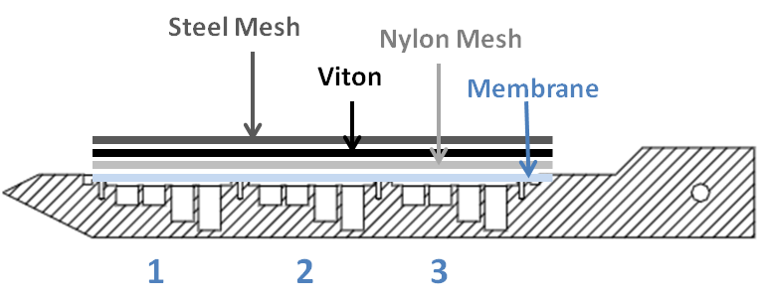
Effects of groundwater velocity on k_{m} – Experimental Approach
Specialized HRPP’s with only velocity cell sets
Equilibrate laboratory flow box with 100 mg/L Cl⁻ solution
Fill HRPP cells with 100 mg/L Br⁻ solution
Insert HRPP into flow box
Remove HRPP after predetermined number of days and measure Br⁻
Change velocity through flow box and repeat 1-4

Slide 24

Effects of groundwater velocity on k_{m} – Data Analysis
Plot C/Co vs. F and fit equation for k_{m}
Measure Br- concentration after HRPP is extracted
1
Do this for each of the 3 replicates and take average k_{m}
2
3
20
10
4 different F values per set of cells
5
1

Slide 25
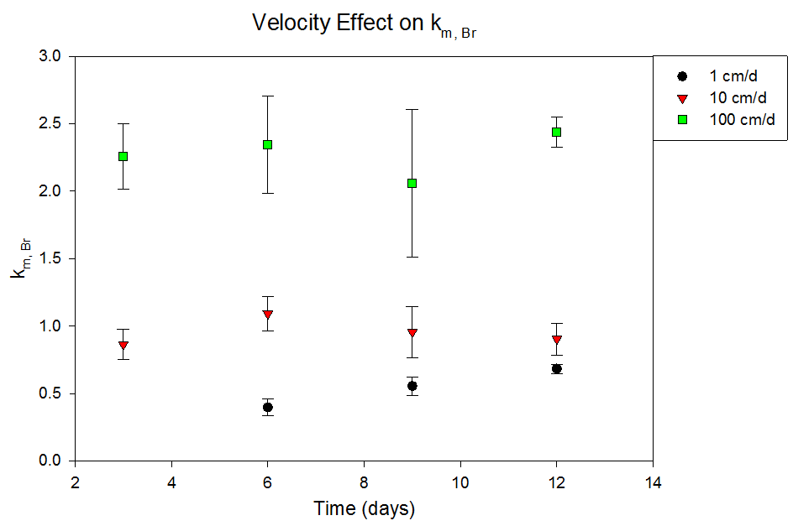
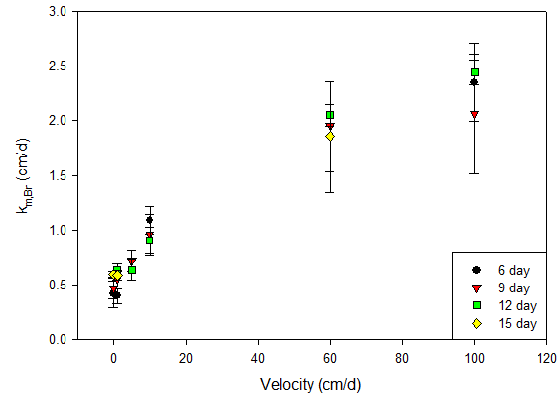
Effect of Velocity on k_{m} - Results
Averaged replicate k_{m} measurements –
3 velocities at multiple time points
Key points:
k_{m} increases with velocity
k_{m} is independent of time
Averaged replicate k_{m} measurements –
multiple velocities and time points

Slide 26
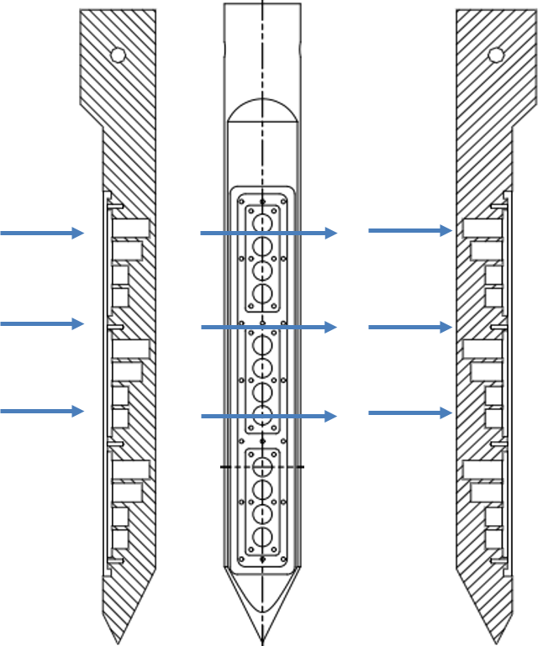
Effects of orientation to flow on k_{m} – Experimental Approach
Original orientation
90º rotation
180º rotation
Flow
Repeat velocity experiments in lab flow cells with HRPP rotated 90º and 180º

Slide 27
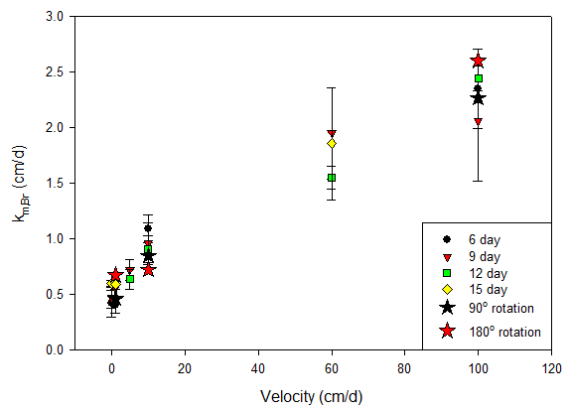
Effects of orientation to flow on k_{m} – Results
k_{m} for 90º and 180º rotated HRPP compared to original orientation
Original orientation
90º rotation
180º rotation
Flow
Long enough equilibration times to reach steady state

Slide 28
Supporting Information
3D Numerical Model

Slide 29
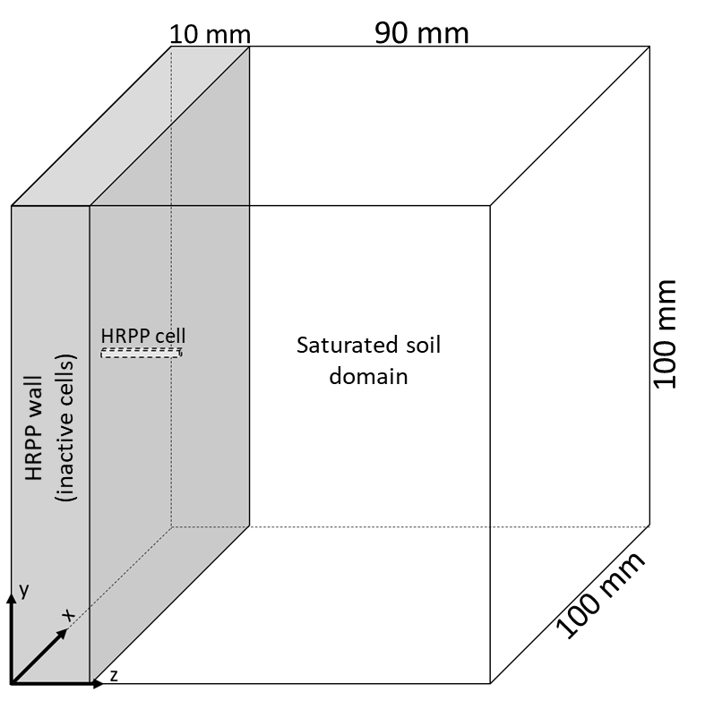
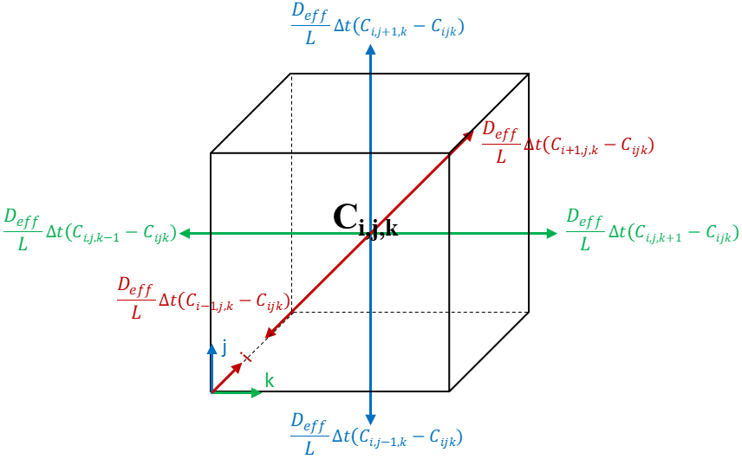
Model Domain and Soil Cell Mass Balance

Slide 30
Model Results – Range of Aquifer Porosities

