Slide 1
Specialty Electrical Resistivity Imaging at NAPL-Impacted Site in Brazil: Key Contributions to the Conceptual Site Model
Eleventh International Conference on Remediation of Chlorinated and Recalcitrant Compounds
Palm Springs, California
April 11, 2018
Carol S. Mowder, Jacobs
Lucas Ribeiro, Paola Barreto, Paulo Rego, Gerd Van den Daele and Olivier Maurer, Jacobs
Mike Sherrier and James K. Henderson, DuPont
CH2M is now Jacobs

Slide 2
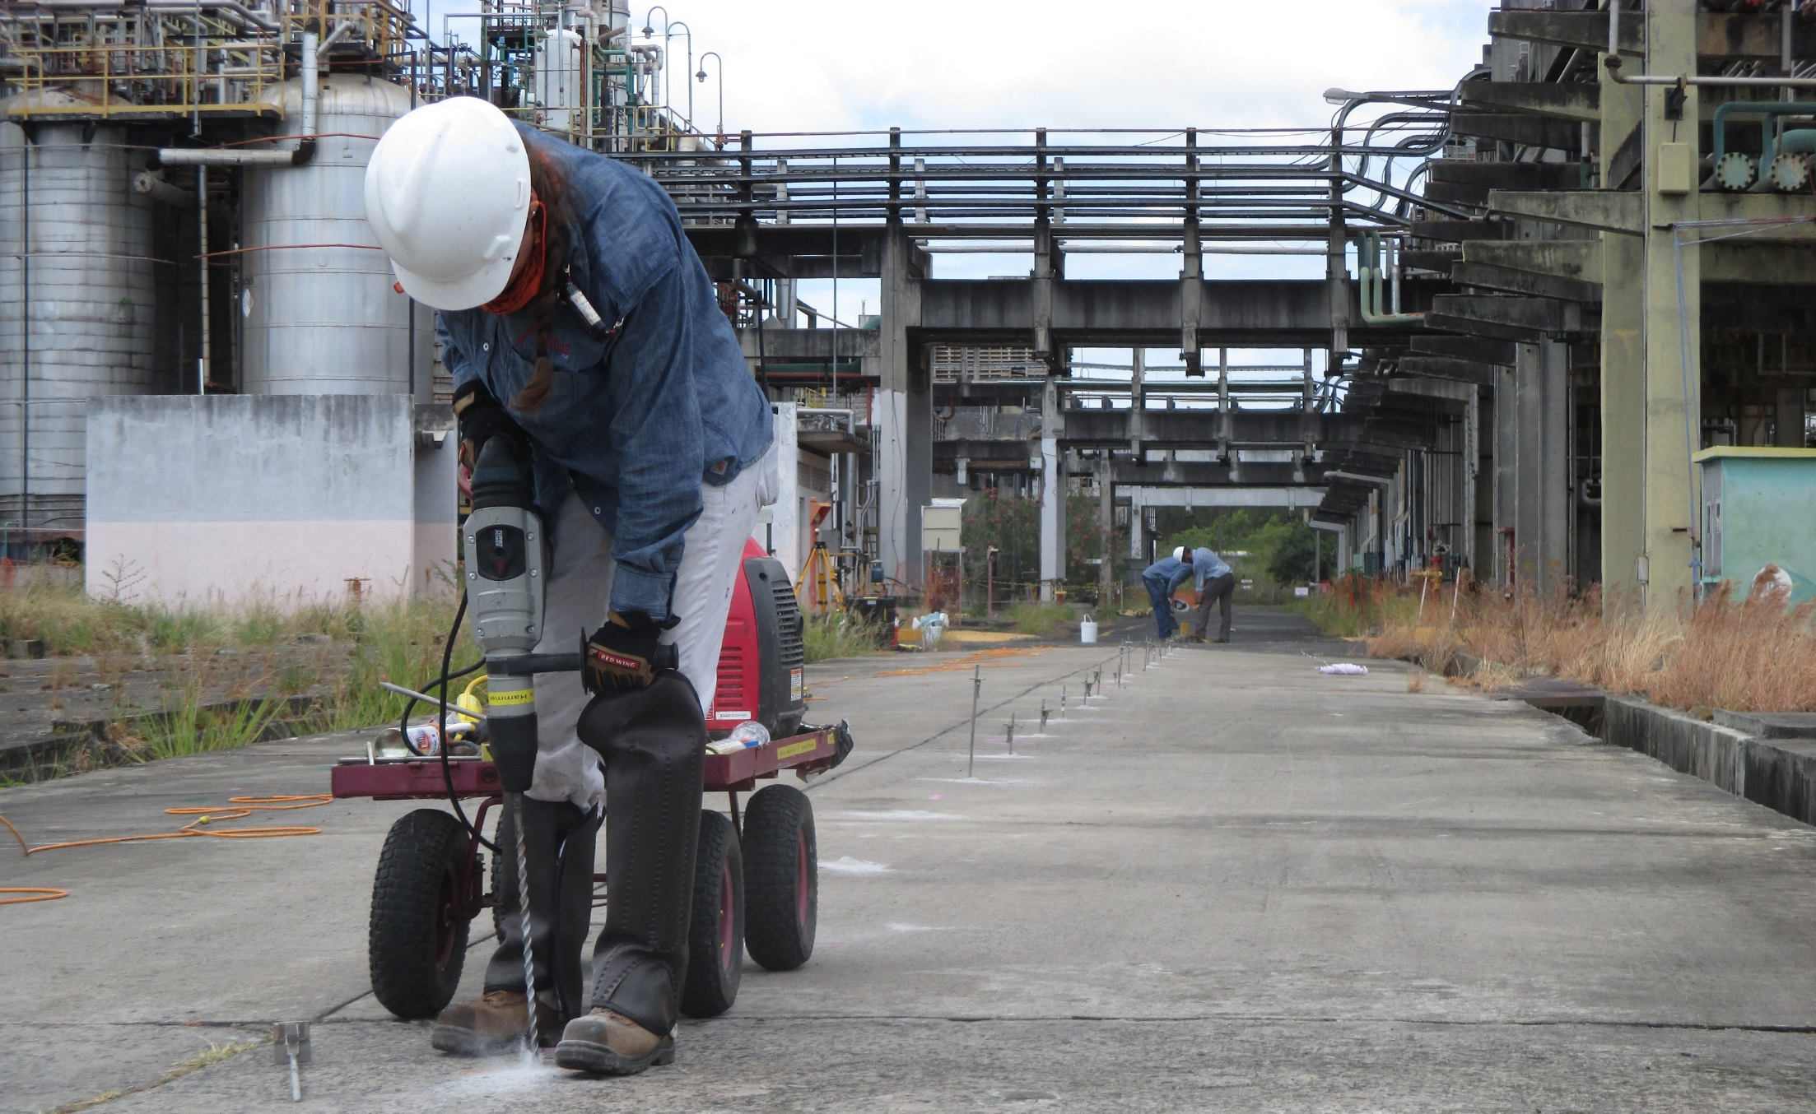
Outline
Site Background
Questions to be Answered
Why Electrical Resistivity Imaging?
Approach
Results/Lessons Learned

Slide 3
Site Background
Site Background
Questions to be Answered
Why Electrical Resistivity Imaging?
Approach
Results/Lessons Learned

Slide 4
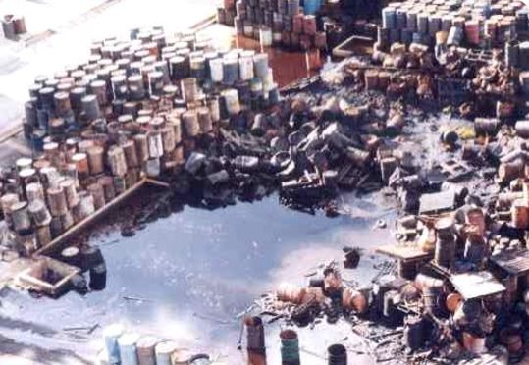
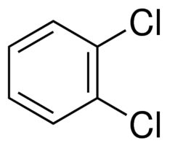
Site Operations
Operated 1987 - 2014
Produced agrochemicals, chemical intermediates, dyes and pharmaceuticals
Primary Constituents of Concern:
  Chlorobenzene, dichlorobenzenes
  Dichloronitrobenzenes (DCNBs)
  Chloroanilines
  Toluene, benzene
S = 92 mg/L; D = 1.56 g/cc
VP = 0.006 mm Hg
O₂N
H₂N
S = 500 mg/L; D = 1.1 g/cc
VP = 12 mm Hg
S = 156 mg/L; D = 1.3 g/cc
VP = 1.36 mm Hg
S = 121 mg/L; D = 1.56 g/cc
VP = 0.01 mm Hg
Notes:
oDCB – Sol – 156 mg/L; density – 1.3 g/cc
DCNB – Sol – 121 mg/L; density – 1.56 g/cc
DCA – Sol – 92 mg/L; density – 1.56 g/cc
Benzene – Sol – 1790 mg/L; density – 0.88 g/cc
CB – Sol – 500 mg/L; density – 1.1 g/cc; VP = 12 mm Hg

Slide 5
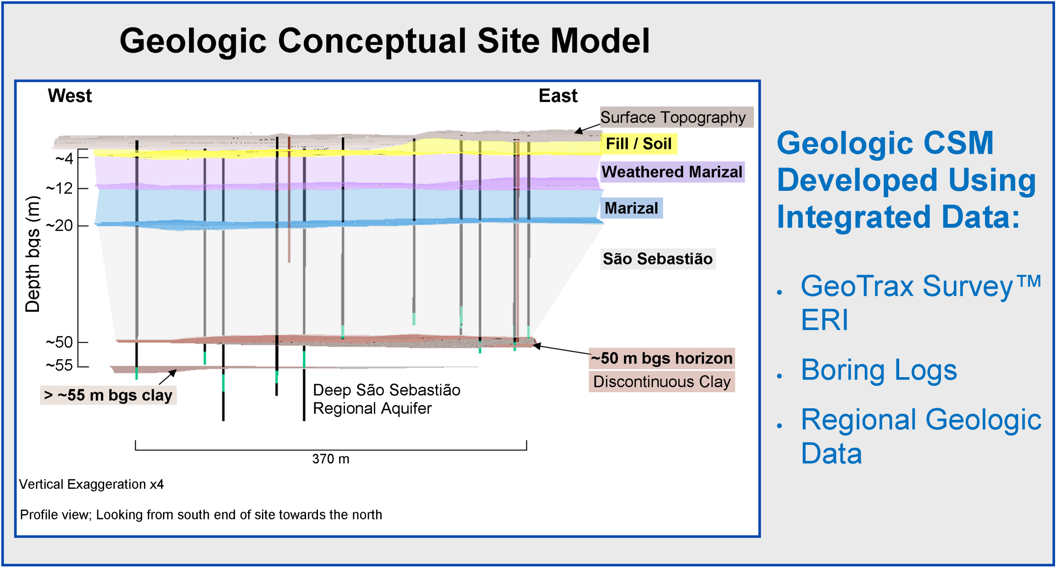
Geology and Hydrogeology
Highly heterogenous
very fine - coarse grain sands, silts, and clays
Upper Site Aquifer
Fine to medium sands,
(flowing),
Interbedded clay lenses, aquitard?
Lower Site Aquifer
Water Supply
regional aquifer

Slide 6
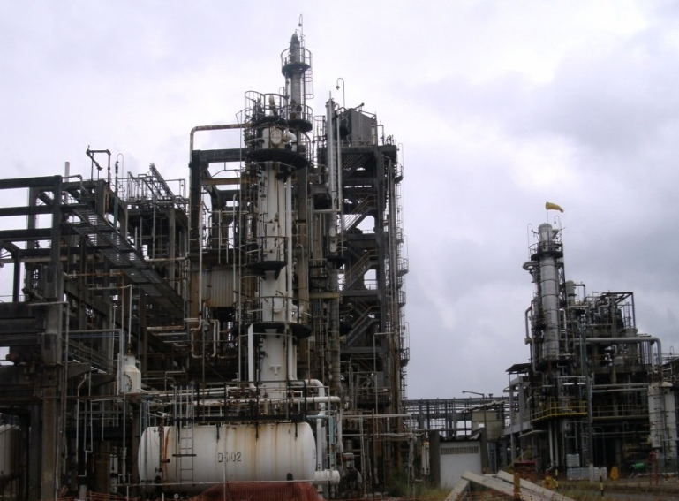

Conceptual Site Model
Multiple historic sources
Secondary sources remain
Mostly residual non-aqueous phase liquid (NAPL)
Dissolved phase plume
Two hydraulic barrier systems
  0 - 15 mbgs
  15 - 45 mbgs
Primary Source
Secondary Source
Secondary Source
Dissolved Phase
Unsaturated zone
Saturated zone
Notes:
Density of on-site NAPL – 1.43 g/mL

Slide 7
Questions to be Answered
Site Background
Questions to be Answered
Why Electrical Resistivity Imaging?
Approach
Results/Lessons Learned

Slide 8
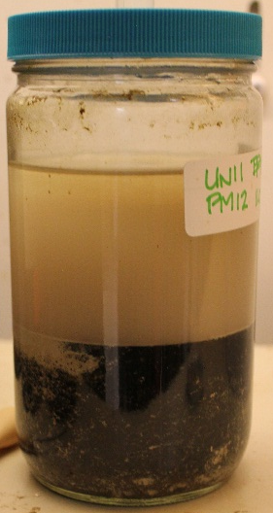
Questions……
Where is NAPL present and how deep does it go ?
Is the aquitard (~50 mbgs) continuous across the site ?
At what depth is the contact between the Marizal and the São Sebastião? How does this affect the conceptual site model (CSM)?
How and where are contaminants migrating ?

Slide 9
Why Electrical Resistivity Imaging (ERI)?
Site Background
Questions to be Answered
Why Electrical Resistivity Imaging?
Approach
Results/Lessons Learned

Slide 10
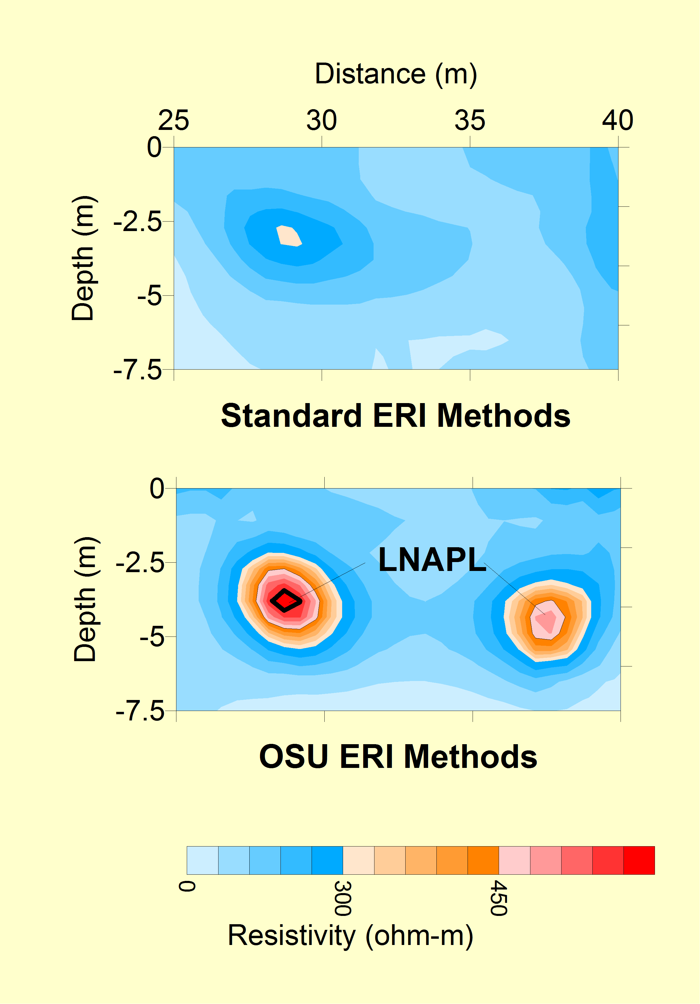


What to Use?
ERI
NAPL Extent?
Lithology?
Access Challenges
Drilling Challenges
Image lacks sufficient sensitivity
to detect NAPLs
Notes:
We have a number of questions to answer to refine the CSM (NAPL extent, lithology, flow paths) and we also have challenges associated with access (infrastructure/buildings). Even where we have access, there are limitations associated with drilling capabilities (e.g., no sonic rigs in Brazil)/lithology (DPT refusal). The reason we were interested in ERI is that it is a non-intrusive scan from the surface that detects differences in how the subsurface environment conducts electricity. Lithology and groundwater affect the ERI image, as does contamination and biological activity. Because the approach is non-intrusive, there isn’t a lot of IDW generated and it produces A LOT of data points quickly. We selected Aestus’ GeoTrax approach because it uses a different data acquisition and processing approach from traditional ERI, and focuses on where current doesn’t go in the subsurface.

Slide 11

Typical Environmental Site Electrical Properties
Saltwater
Bioactivity
(proximate to weathered NAPLs)
DNAPL
(unweathered)
Plumes w/
High GW EC
(metals, etc)
Injectates
(e.g., oxidants)
Aqueous Phase Contamination
(NAPL related)
LNAPL
(unweathered)
Signal Priority
Groundwater
Soil Contamination
(NAPL related)
Clay, Silt, Sand, Rock
Less Electrically Resistive
(More Electrically Conductive)
Resistivity (ohm-m)
More Electrically Resistive
(Less Electrically Conductive)
Resistivity increases with NAPL saturation level
NAPL
Water
Soil Particles
Notes:
There’s a wide range of how electrically conductive or resistive subsurface materials are. And different things that we care about in the environmental space – contaminants, NAPL, biological degradation – disrupt those natural patterns and can leave a “signature”. But it’s important to understand that the data collected represent the “average” or “bulk property” for the “cell block” that is represented. We’ve collected some soil cores to run NAPL saturation tests (where NAPL has been visually observed) and the results are on the order of 1-6% NAPL saturation (Dean Stark method).

Slide 12
Approach
Site Background
Questions to be Answered
Why Electrical Resistivity Imaging?
Approach
Results/Lessons Learned

Slide 13
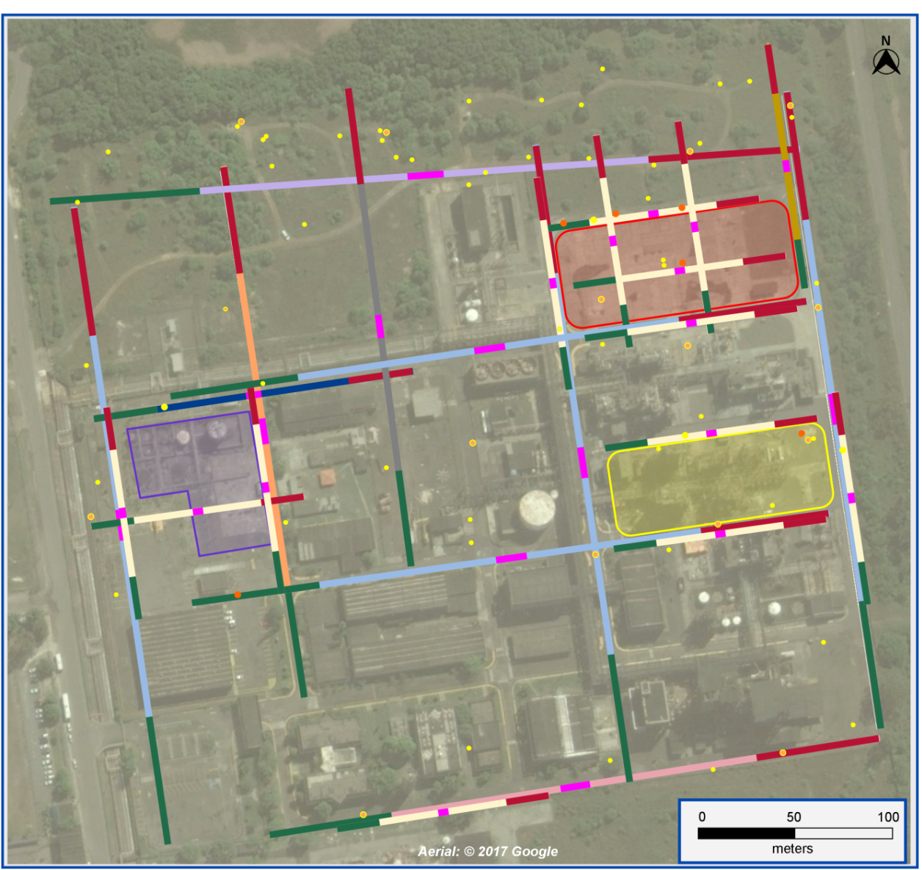
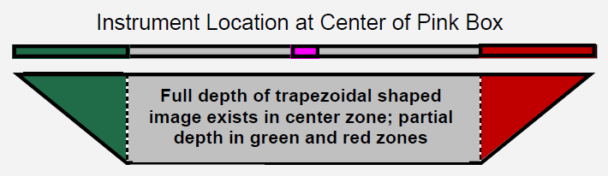

ERI Surface Geophysics
15 Shallow transects
  ~110 m long (electrode spacing ~2 m)
  ~22 m deep
9 Deep transects
  ~330 m long (electrode spacing ~6 m)
  ~66 m deep
“Background” and impacted areas
Co-located shallow and deep transects (sensitivity comparison)
Notes:
Units 11/12 – Chlorination.
Other units were used for nitration, hydrogenation, hydrolysis and Diuron production.

Slide 14
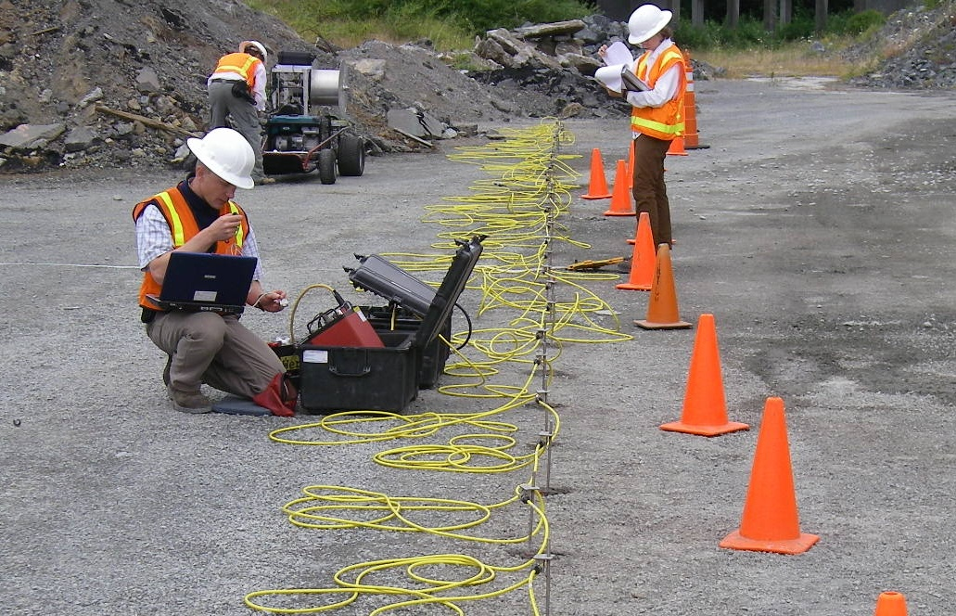
ERI Surface Geophysics (cont’d)
1 month to complete field work
Compared ERI results to existing data
  Soil analytical
  Groundwater analytical
  DNAPL observations
  Membrane interface probe/hydraulic profiling tool (MiHPT)
Performed confirmatory sampling of select ERI anomalies

Slide 15
Results/Lessons Learned
Site Background
Questions to be Answered
Why Electrical Resistivity Imaging?
Approach
Results/Lessons Learned

Slide 16
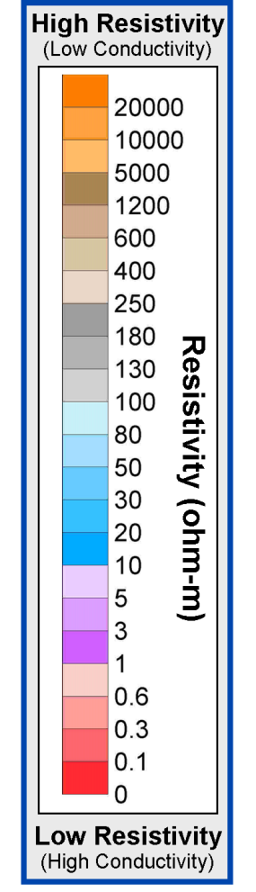
What We Saw
Resistive anomalies
> 5,000 ohm-m considered “significant” (orange)
Reference value:
  “Clean sand” ~ 100 ohm-m
General Site Summary:
More resistive anomalies in Tank Farm and along eastern property boundary
Highly conductive anomalies in eastern half of the site and at depth
90th percentile (> 2200 ohm-m)
10th percentile (< 5.8 ohm-m)
Conductive anomalies < 1 ohm-m considered “unusual” (pink/red color used in graphics)

Slide 17
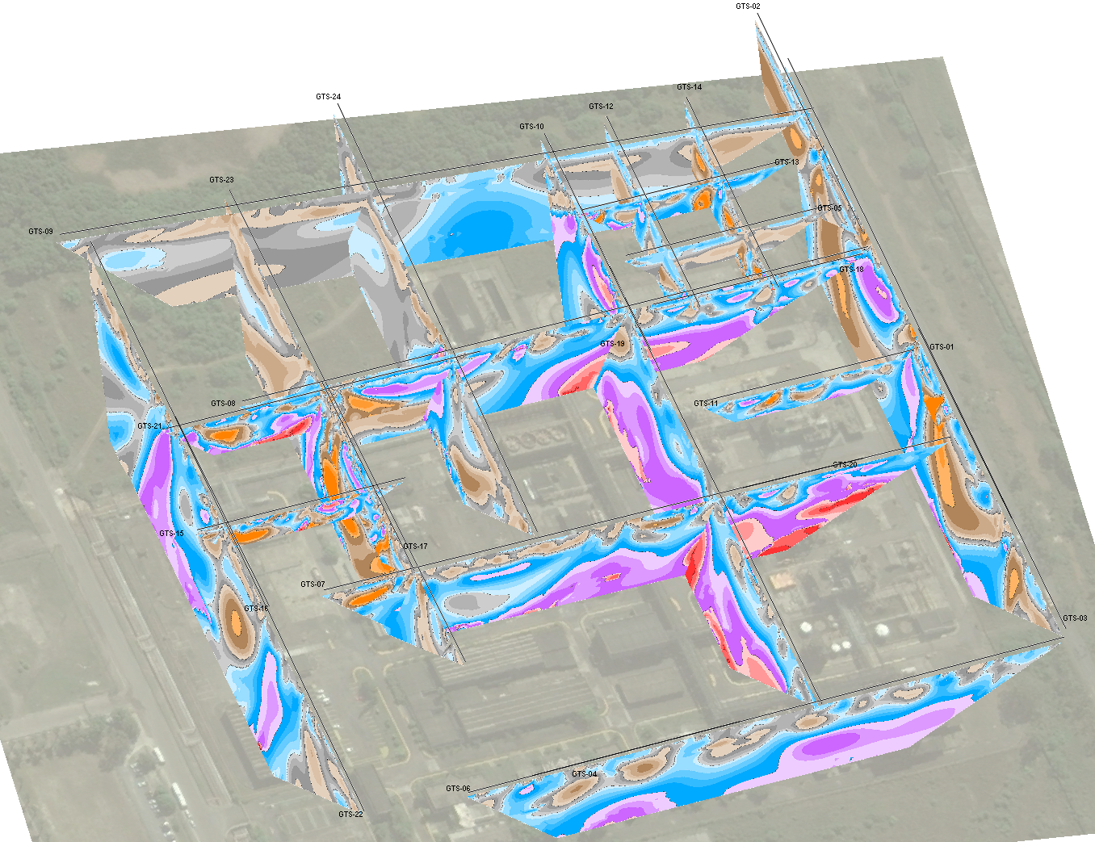

What We Saw (cont’d)
Extremes in electrical resistivity & conductivity
Reasonable comparisons for co-located shallow & deep transects
But what does this all mean?

Slide 18
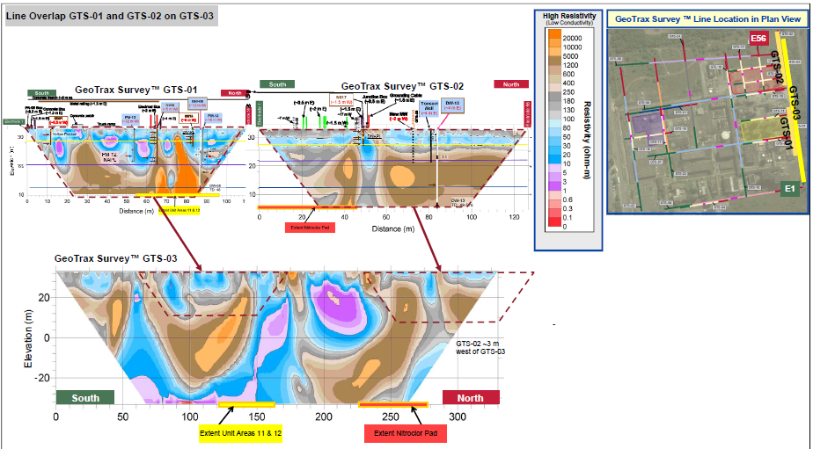
Shallow & Deep Transect Comparison

Slide 19
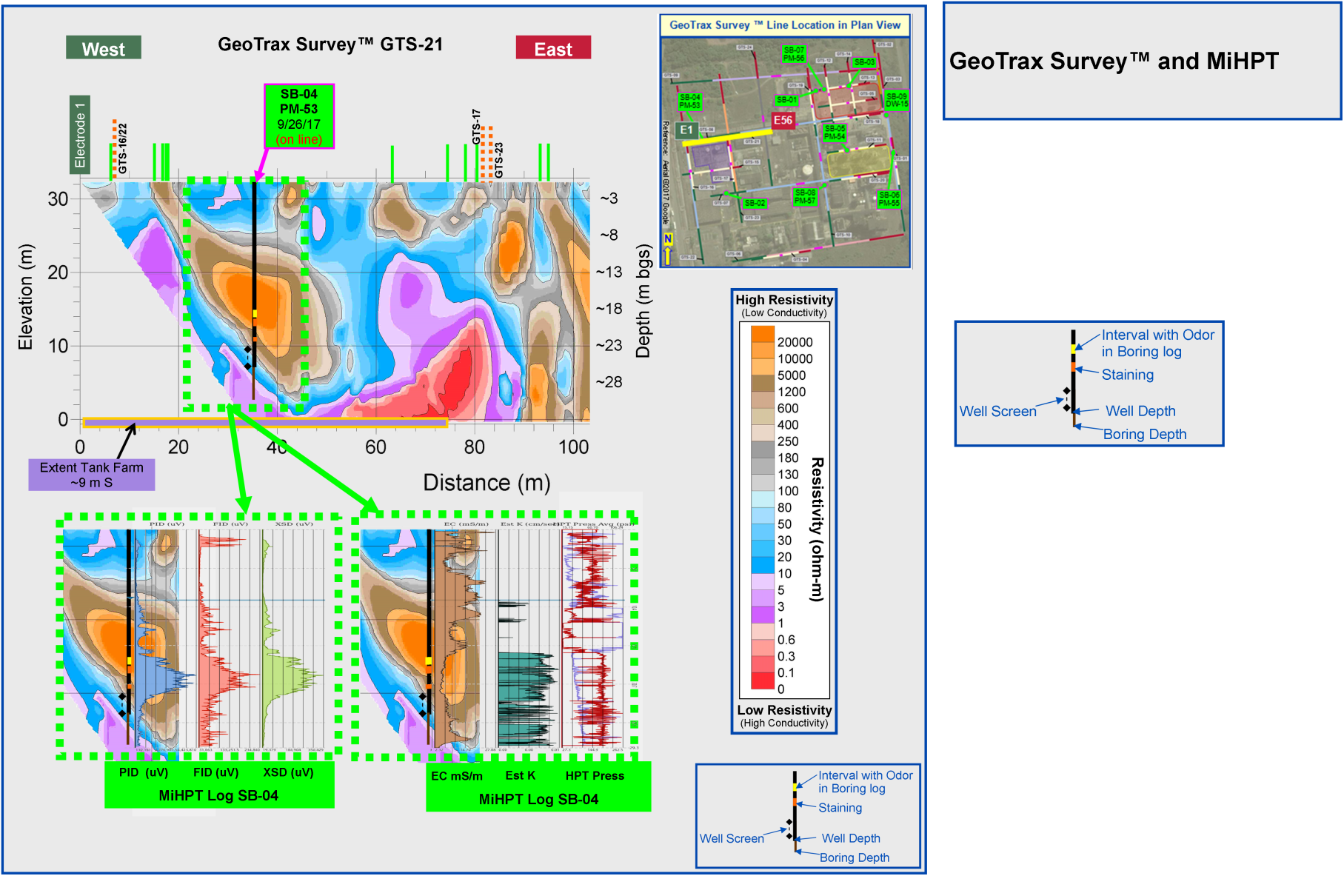
Resistive Anomaly Assessment
ERI transect in the Tank Farm
MiHPT boring SB-04 to assess resistive anomaly
Odor/staining coincident with MiP & high K zone (transport pathway)
Soil samples, 13-21 mbgs, showed no significant detections
MW PM-53 installed; groundwater to be sampled (VOCs, SVOCs, biogeochemical, DNA)
Notes:
The data indicate that there is a hydraulically conductive anomaly with electrically resistive properties. We believe that there are a lot of natural moderately resistive features (100-1000 ohm-m range) in the Upper Site Aquifer that represent natural geologic features (e.g., more permeable gravels zones). When we see extreme values for resistivity (i.e., > 5000 ohm-m) we question whether these more permeable features are impacted with contaminants. The depth of this feature, and the lack of elevated MiP results at shallow depths, suggests that the impacts observed in this feature may have originated from an upgradient area. The lack of detections in the soil may be associated with the architecture of the soil/contaminant distribution (NAPL blocking e- flow outside of the area), or it may reflect dissolved phase contamination (awaiting results).

Slide 20
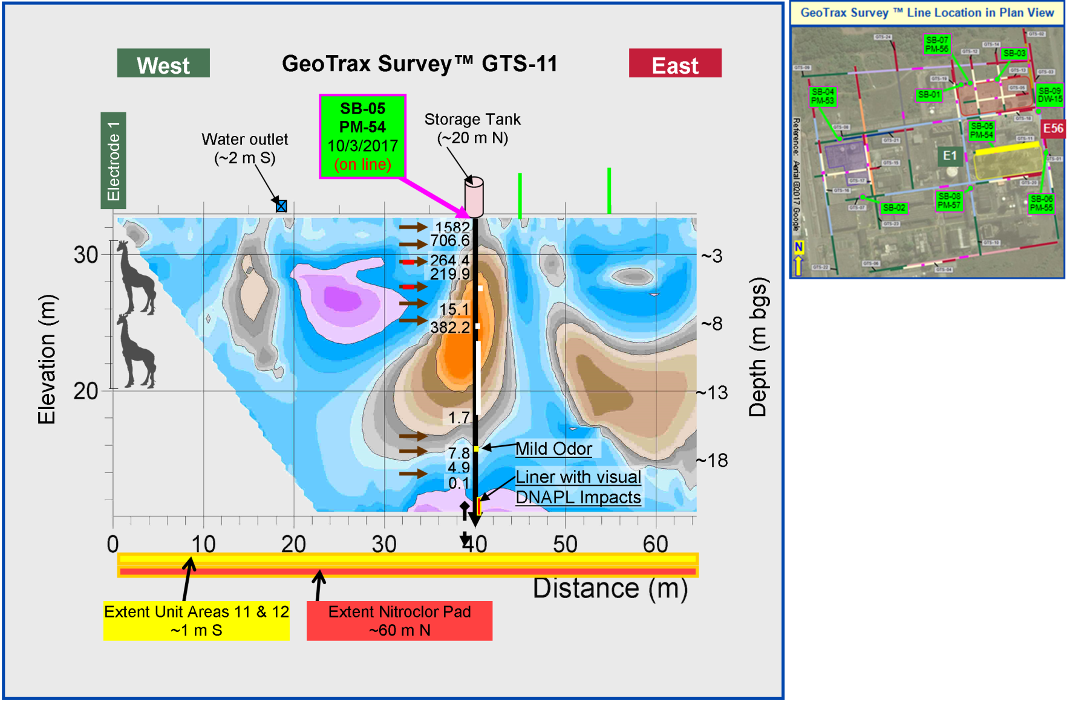
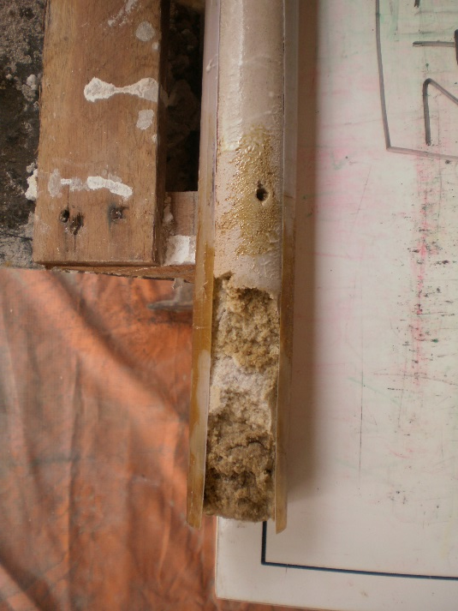
Resistive & Conductive Anomaly Assessment
ERI transect adjacent to source area
MiHPT boring SB-05 to assess resistive & conductive anomalies
Elevated MiP & PID shallow (< 8 mbgs)
Soil sample, 24 mbgs (conductive anomaly), showed >12,000 mg/kg DCNB
MW PM-54 installed; groundwater to be sampled (VOCs, SVOCs, biogeochemical, DNA)

Slide 21
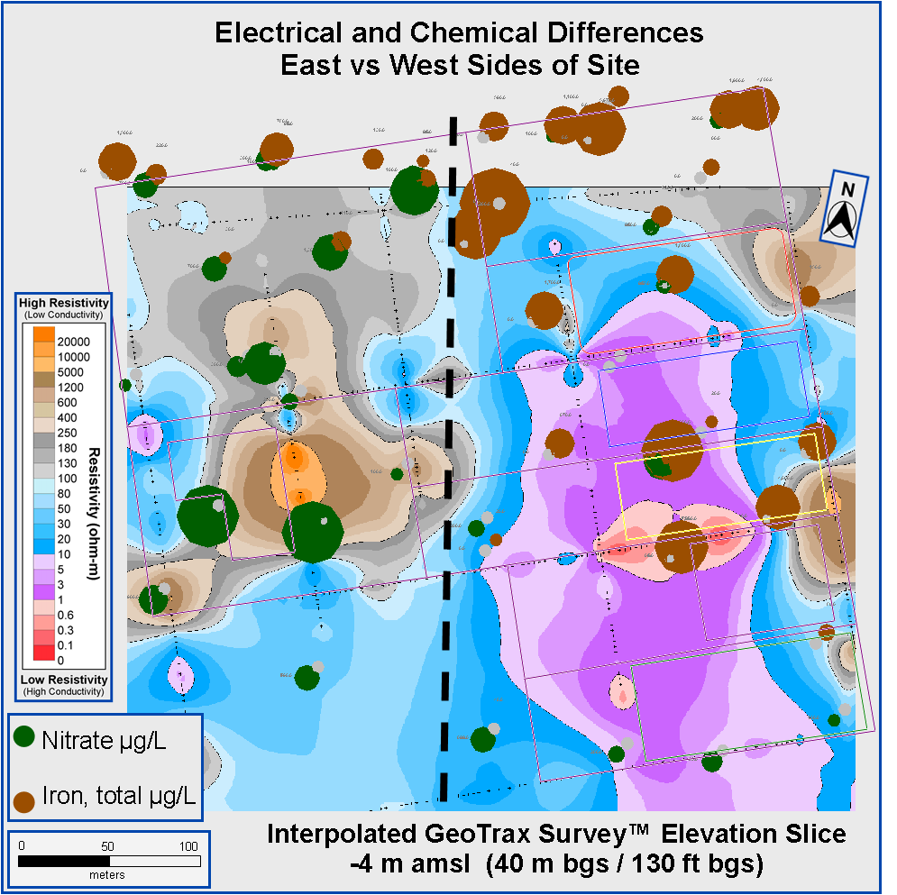

Comparison of Groundwater Data and ERI
40 mbgs layer (Lower Site Aquifer)
East side of site
  Electrically conductive
  Low nitrate/elevated iron (more reducing)
West side of site
  Electrically resistive
  Elevated nitrate/low iron (less reducing)

Slide 22
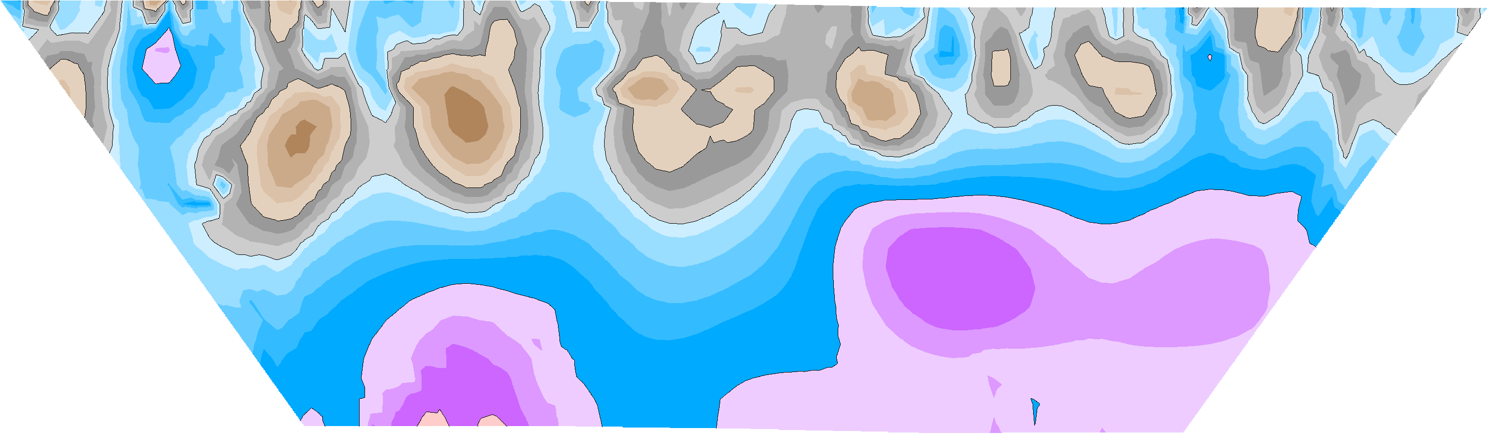
ERI Data Support the Conceptual Site Model
50 m
N
Legend
MiHPT
Natural Gamma
ERI Transect
mbgs
HSU
Upper Marizal Fm
15
4
Lower Marizal Fm
24
3
?
Refusal layer
Upper São Sebastião Fm
50
?
60
2
Aquitard
1
Lower São Sebastião Fm
80

Slide 23

Did ERI Answer our Questions?
Where is NAPL present and how deep does it go?
  Data suggest NAPL is limited to the Marizal
Is the aquitard (~50 mbgs) continuous across the site?
  No (based on geophysics & borings)
At what depth is the contact between the Marizal and the São Sebastião? How does this affect the conceptual site model (CSM)?
  Approximately 24 mbgs
  ERI data indicate shallow geologic features within the Marizal; evidence of NAPL at the base of the Marizal
How and where are contaminants migrating?
  Preferential pathways in high hydraulic conductivity zones, toward hydraulic barrier system (extraction wells)
BUT…..we are awaiting soil, groundwater and DNA data to help us understand differences between conductive and resistive anomalies

Slide 24
Thank you!
Carol S. Mowder, P.E.
carol.mowder@ch2m.com

