Slide 1
Using Environmental
Molecular Diagnostics to support a
Rhizodegradation Closure Strategy at a Service Station Site
Jack Sheldon
Battelle Conference
Palm Springs, CA
April 12, 2018

Slide 2
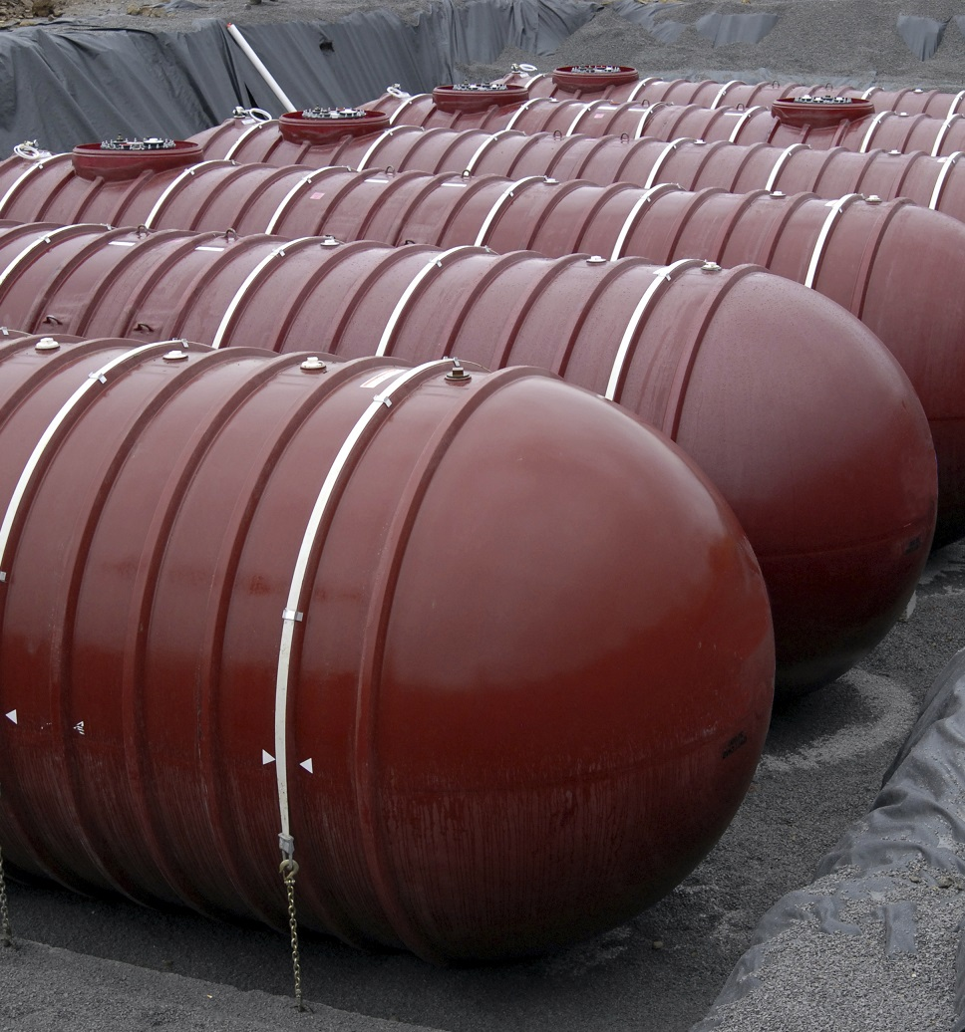



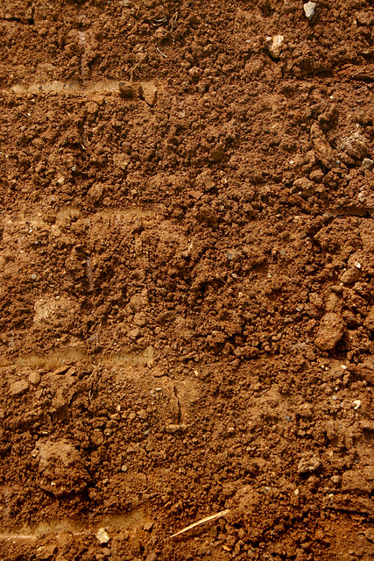
The Site
The Strategy
The Results

Slide 3
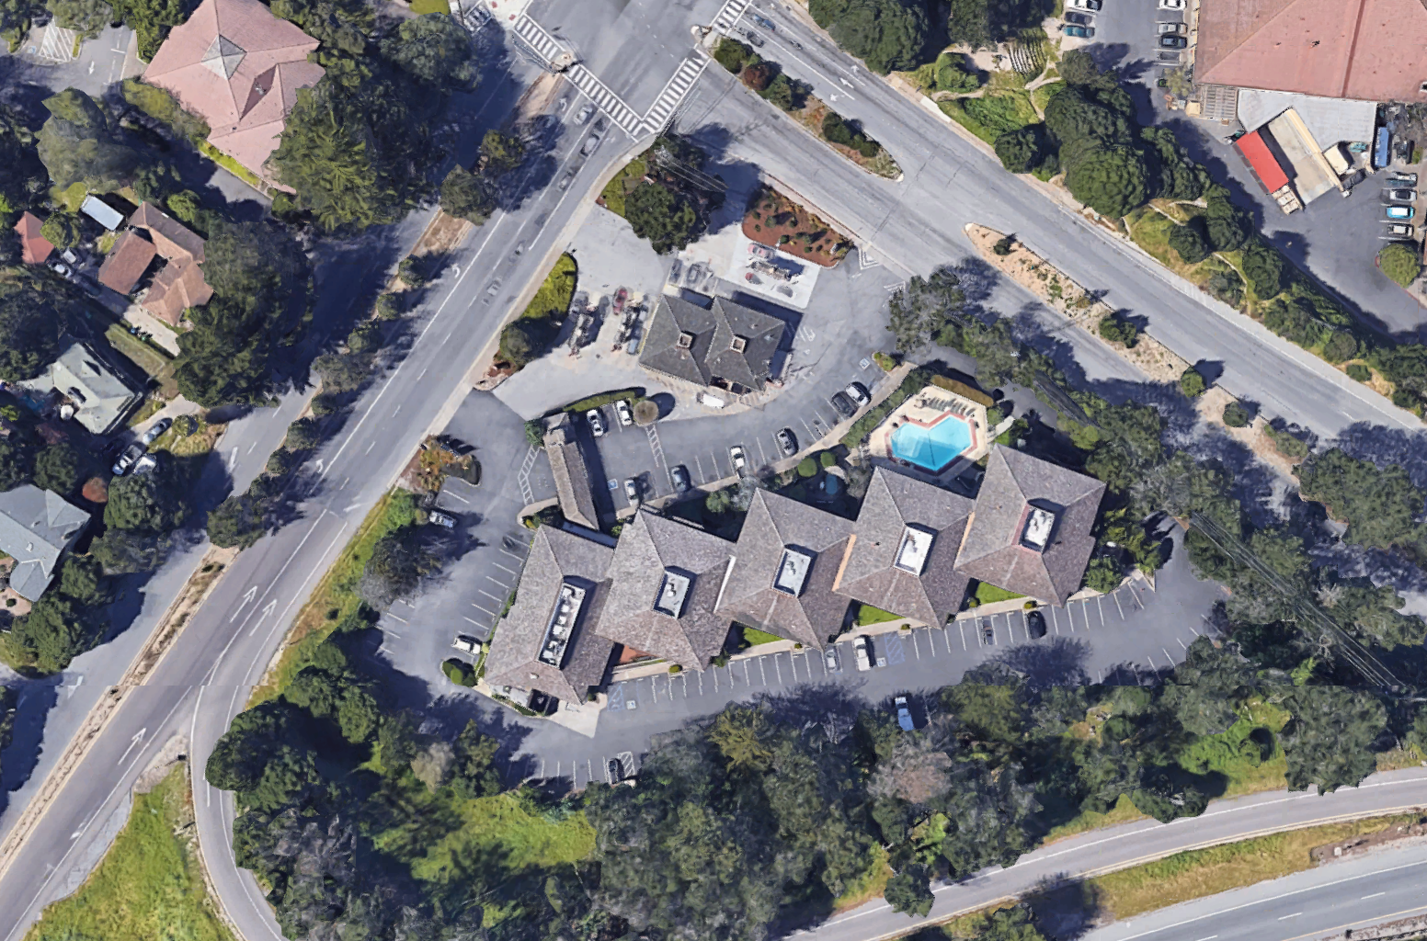
From the Sky – Former 76 Station, Monterey, CA
Soledad
Drive
Munras Avenue

Slide 4

The History
Former gas station with prior leaking UST
This is an ELT
Minimal impacts remain on-site
Off-site groundwater is the current focus due to surface water risk
State and regional water boards regulate site

Slide 5
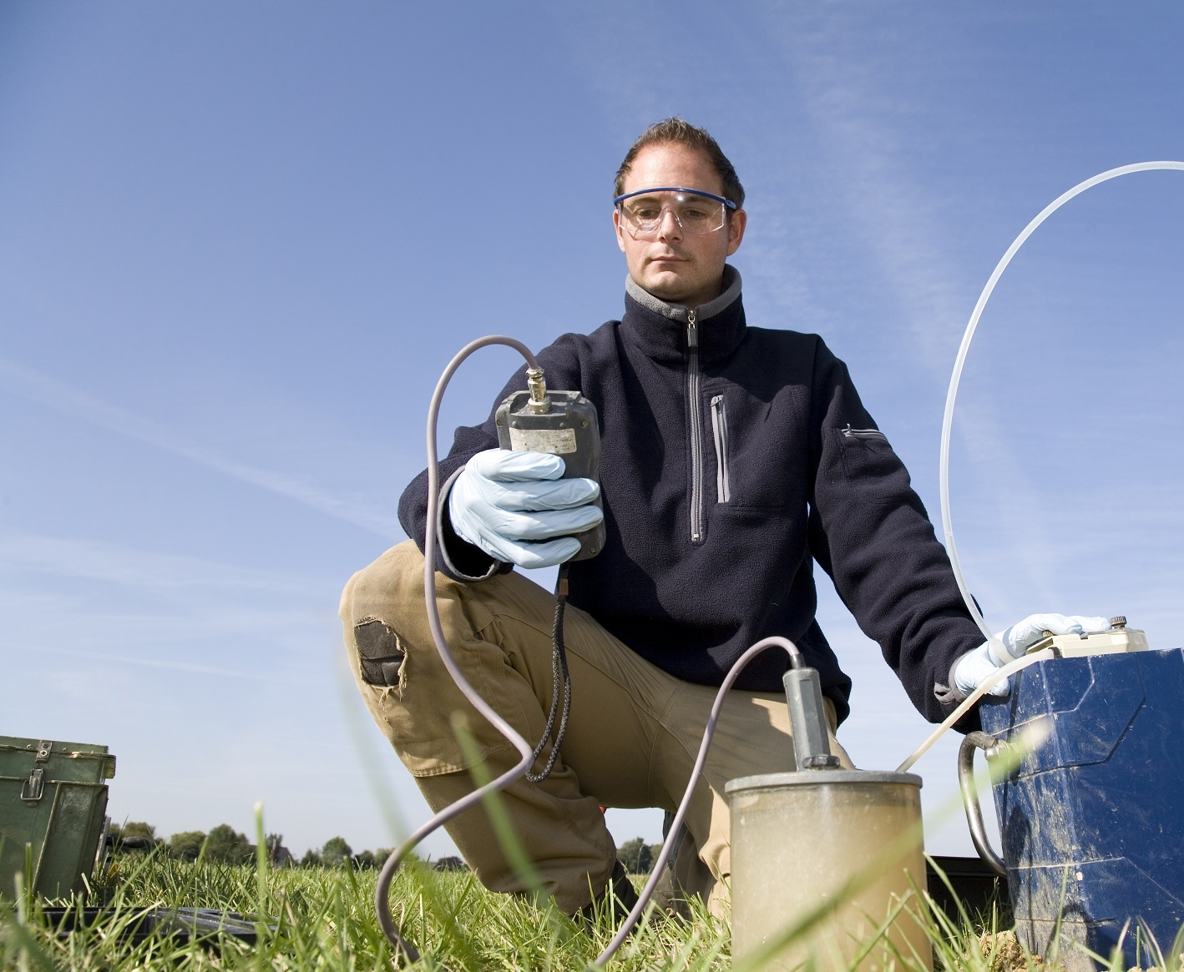
The History – Part 2
AS/SVE, excavation with bioamendment and MNA important remedies on-site
Site responded well to increased dissolved oxygen
Plume migration through narrow channel and limited to ~10 ft. vertical horizon
No surface water detections observed during the life cycle of the project
Initial closure request denied because of surface water proximity < 100 ft.

Slide 6
Site Geology

Slide 7
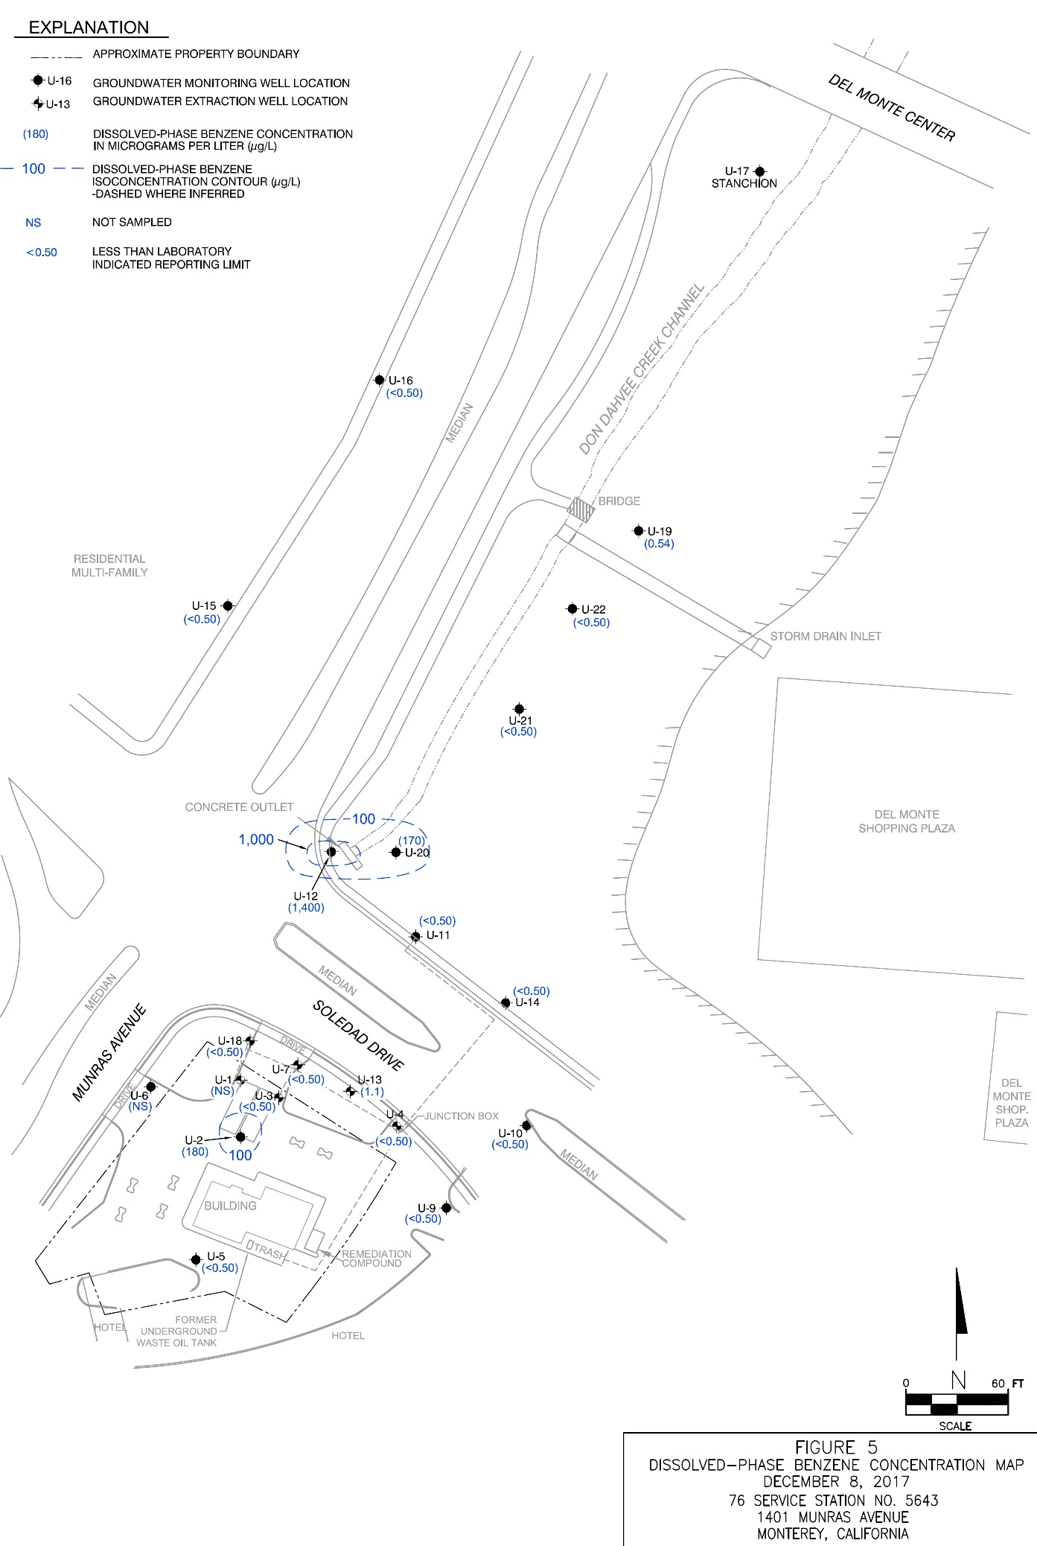
Groundwater Data
-Benzene

Slide 8
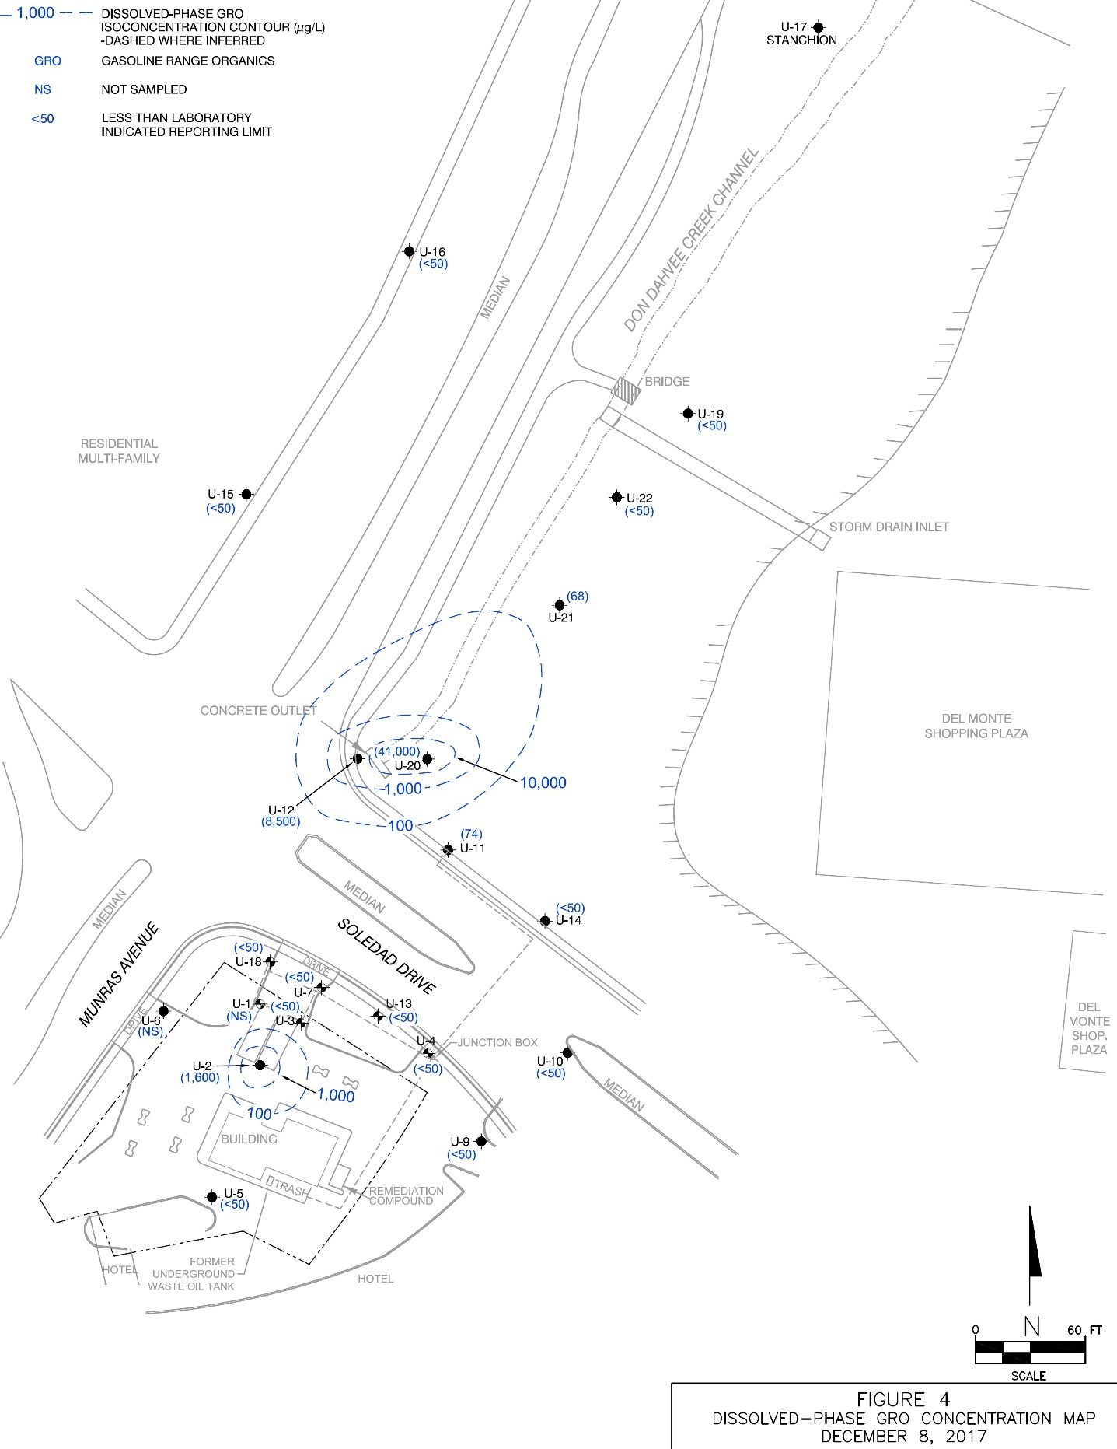


Groundwater Data
-TPH-GRO

Slide 9
The Site
The Strategy
The Results

Slide 10
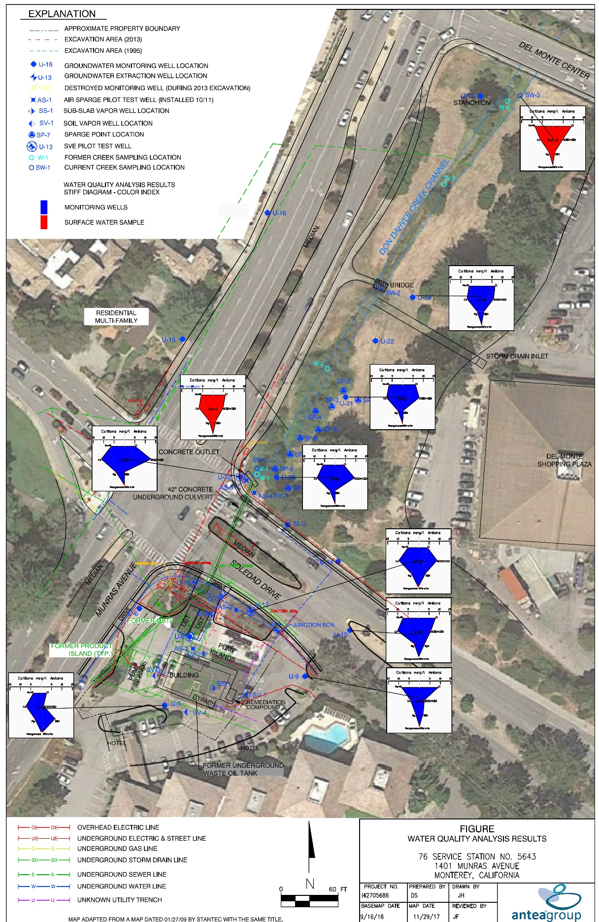

Groundwater
-Chemistry

Slide 11

Phytoremediation Processes
Volatilization with ET
Degradation in the Plant
1
Root Exudates = Microbial Activity
Hydraulic Uptake and Control
2

Slide 12
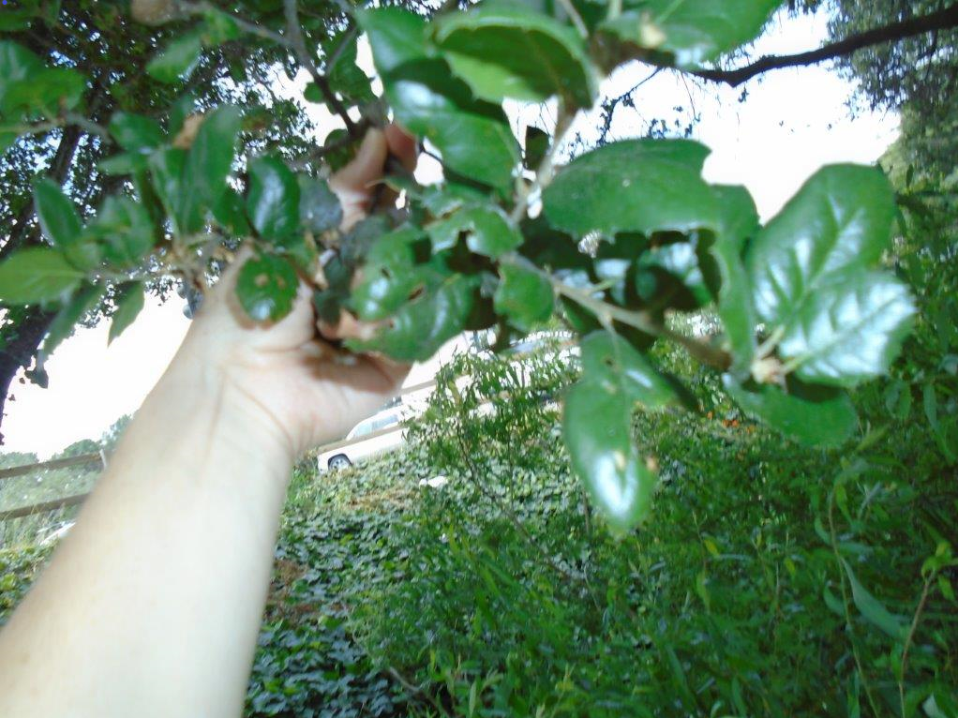
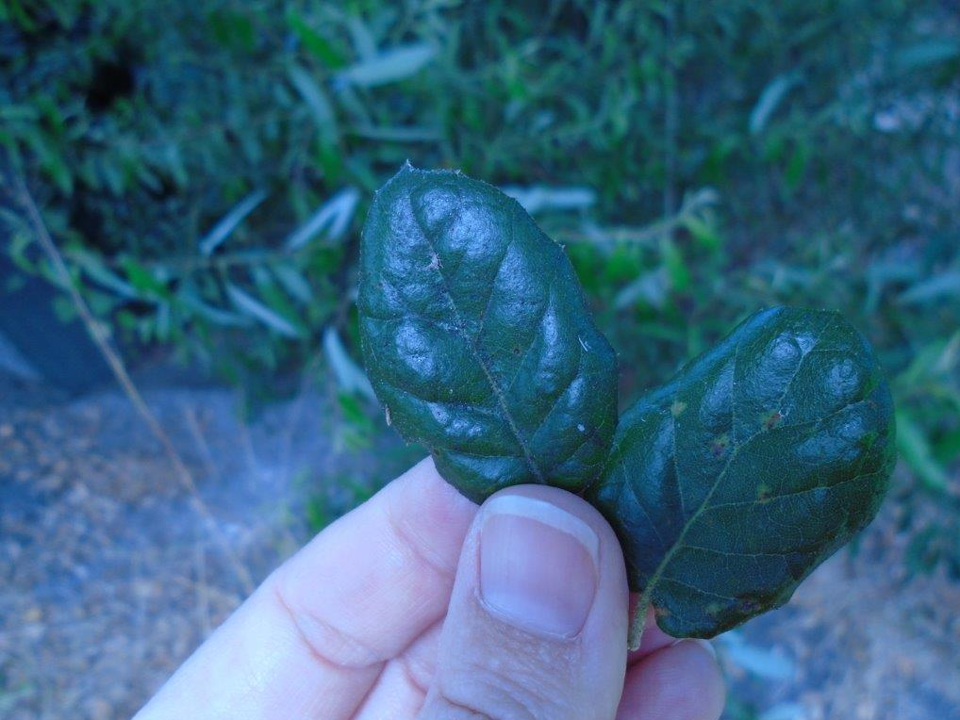
Visual Inspection

Slide 13
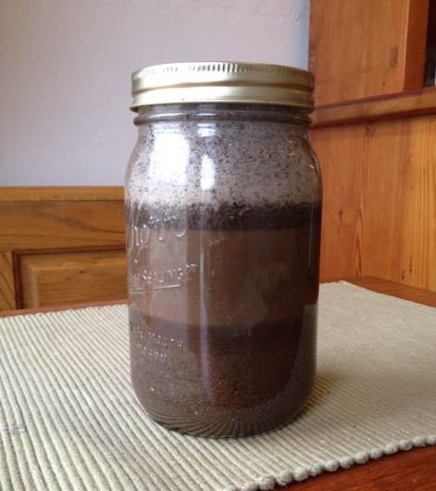
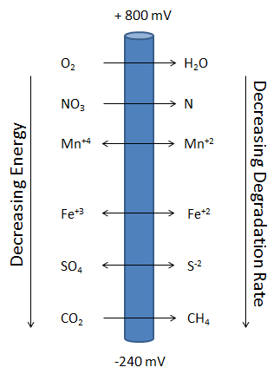
Soil Microbial Sampling and Geochemistry

Slide 14
Site Characteristics Conducive to Phyto
Deep rooted live oak trees
No phytotoxic BTEX levels present
Well documented history of BTEX being degraded through phyto
Shallow groundwater where the root zone of Quercus agrifolia (California oaks) can reach.

Slide 15
Strategic Approach
Identify soil texture and horizons beneath the trees/grass cover in the target zone
Determine the depth of solum
Three injection points per well per amendment
Determine the microbial profile in the target area and background as well as look for gene functions that are associated with gasoline degradation
Identify soil nutrient conditions

Slide 16
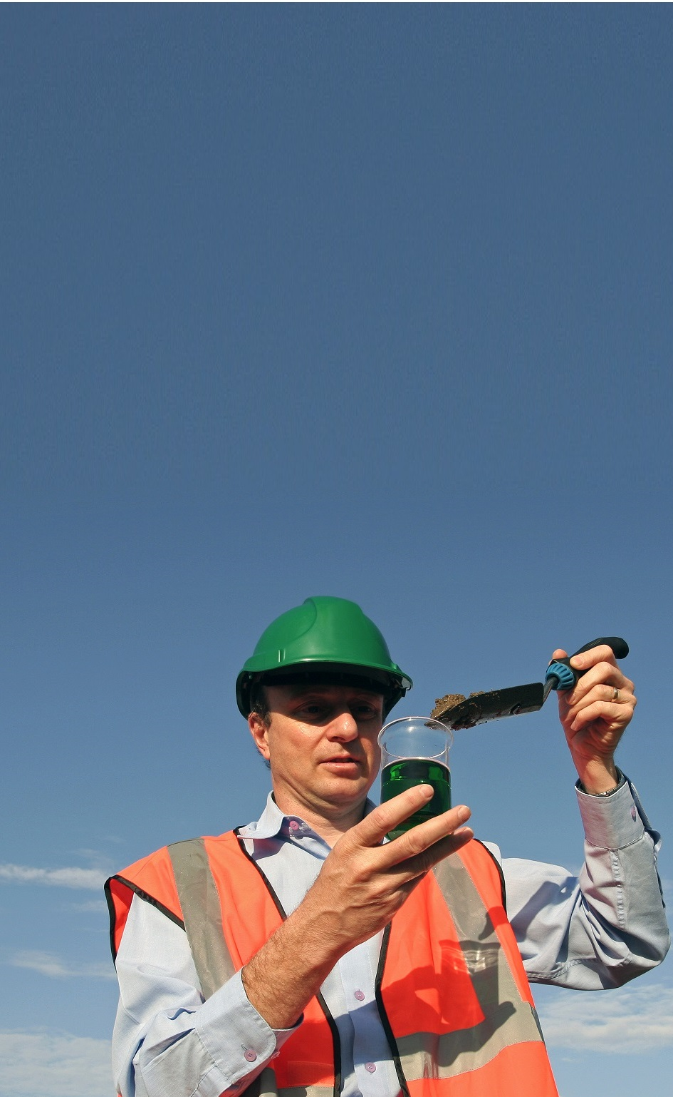
Soil Sample Locations B001 – B004
B004
B003
B002
B001

Slide 17
The Site
The Strategy
The Results

Slide 18
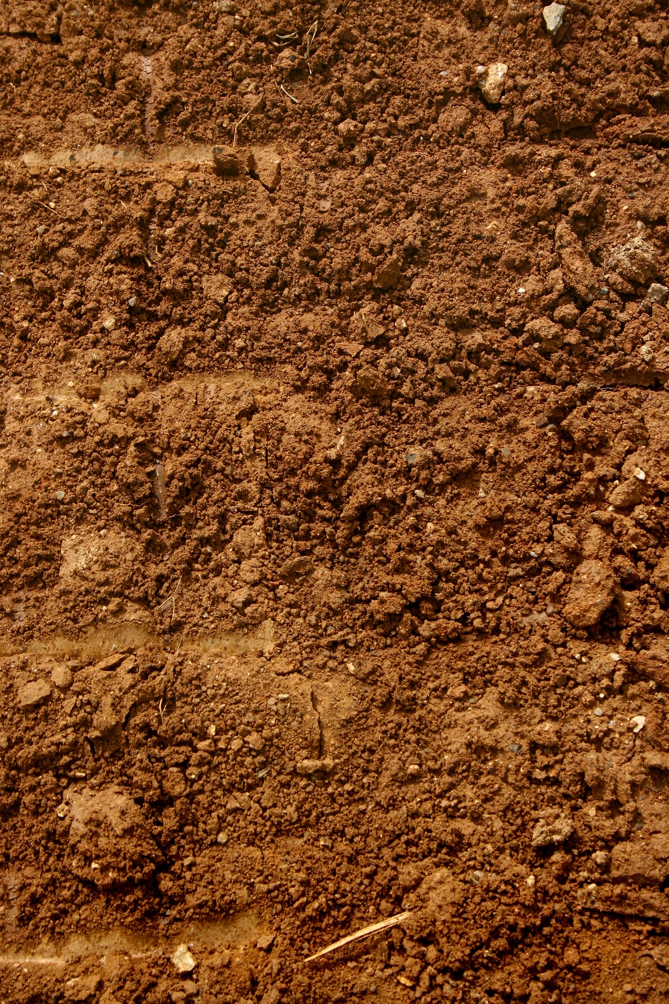
Soil Conditions

Slide 19

Microbial Results
19

Slide 20
Microbial
Profile

Slide 21

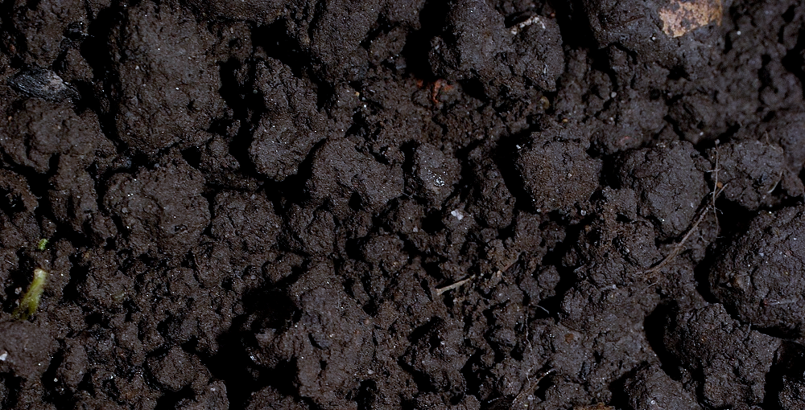
Conclusions from Microbial Profile
High organic content at B002 and B003 caused inhibition of QuantArray analysis
B001 has high densities of total bacteria and sulfate reducing bacteria
Aerobic and anaerobic gene functions for BTEX degradation were present
Lesser densities of gene functions and sulfate reducing bacteria present at B004

Slide 22

Site Evaluation
The oak population has year round access to water and root themselves at the capillary fringe
An optimal microbial growth scenario is present in the rhizosphere that manages moisture, nutrients, and BTEX concentrations through evapotranspiration
Root sloughing and leaf dropping provide an ongoing carbon source to maintain large populations of microbes that foster BTEX degradation
Significant soil organic matter further promotes rhizodegradation of BTEX

Slide 23




Thank You/Q&A
AnteaGroup
@AnteaGroup
Jack Sheldon
US Toll Free 800.477.7411
Mobile +1 515. 971.8329
5910 Rice Creek Parkway, Suite 100 Shoreview, MN 55126
jack.sheldon@anteagroup.com
Acknowledgements:
Jeff Friedman, PG
Antea Group (Long Beach)
Bart Sexton, Mark Dawson
Sand Creek Consultants

Slide 24
BETTER BUSINESS,
BETTER WORLD℠
Antea Group Offices
USA Headquarters
5910 Rice Creek Parkway, Suite 100
St. Paul, MN 55126, USA
USA Toll Free: +1 800 477 7411
International: +1 651 639 9443
Belgium
Roderveldlaan 1
2600 Antwerpen
Colombia
Calle 35 No. 7-25, Piso 12
Bogota, DC
France
29 avenue Aristide Briand - CS 10006
94117 Arcueil Cedex
Netherlands
Monitorweg 29
1322 BK Almere
www.anteagroup.com

