Slide 1
Association Between qPCR Analyses for Oxygenase Enzymes and Rate Constants for Cooxidation of TCE in Groundwater
John T. Wilson (john@scissortailenv.com) and Barbara Wilson
(Scissortail Environmental Solutions, LLC. Ada, OK, USA)
Dora Taggart (dtaggart@microbe.com)
David Freedman (DFREEDM@clemson.edu)

Slide 2
Methane monooxygenase
SMMO
Phenol monooxygenase
PHE
H
OH
H-C-H
C
H
C
C
C
C
C
H
OH
H-C-OH
C
OH
H
C
C
C
C
C

Slide 3
Toluene-2-ring monooxygenase
RMO
Toluene-2,3-dioxygenase
TOD
CH₃
CH₃
C
C
C
C
C
C
C
C
C
C
C
C
CH₃
CH₃
C
OH
C
OH
C
C
C
C
C
C
C
C
OH
C
C

Slide 4
Toluene-3-ring monooxygenase
RMO
Toluene-4-ring monooxygenase
RMO
CH₃
CH₃
C
C
C
C
C
C
C
C
C
C
C
C
CH₃
CH₃
C
C
C
C
C
C
C
C
C
C
C
OH
C
OH

Slide 5
Toluene/Xylene Side Chain monooxygenase TOL
CH₃
C
C
C
C
C
C
O
H
C
C
C
C
C
C
C

Slide 6
All these oxygenases cooxidize TCE
TCE
TCE Epoxide
O
TCE Degradation Products
H
Cl
H
Cl
_
C=C
C
C
Cl
Cl
Cl
Cl

Slide 7
As a first approximation, the relationship between the rate of the cooxidation, the activity of the microorganisms and the concentration of TCE can be described with the Michaelis-Menten Equation.
$$v=v_{max}\frac{S}{\left(K_{m}+S\right)}$$
where: v is the specific rate of the reaction, a zero-order process,
(nmol/(minute*mg cell protein)
S is the concentration of the substrate,
v_{max} is the maximum rate of the reaction at any value of S,
K_{m} is the Michaelis Constant, (K_{m} = S where v = 0.5 v_{max})

Slide 8
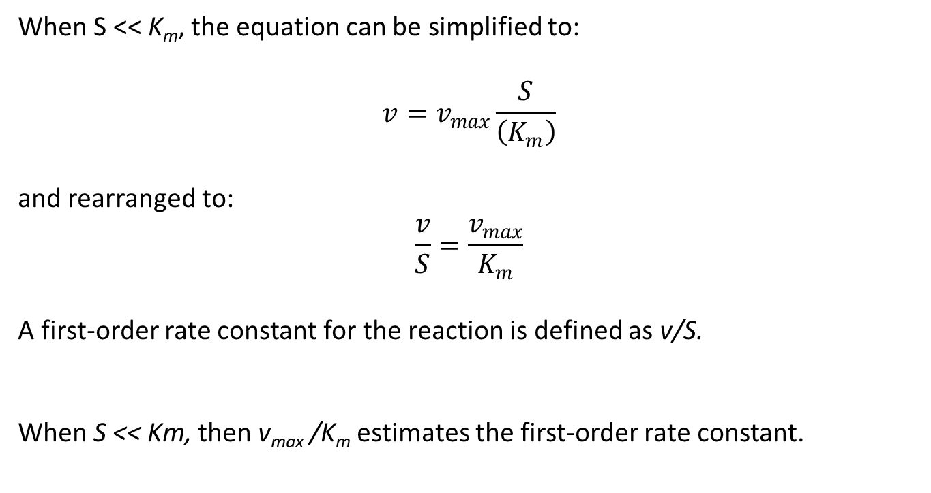
When S << K_{m}, the equation can be simplified to:
$$v=v_{max}\frac{S}{\left(K_{m}\right)}$$
and rearranged to:
$$\frac{v}{S}=\frac{v_{max}}{K_{m}}$$
A first-order rate constant for the reaction is defined as v/S.
When S << Km, then v_{max} /K_{m} estimates the first-order rate constant.

Slide 9
Values for v_{max} and K_{m} for cooxidation of TCE
Sun and Wood. 1996. Applied Microbiology and Biotechnology 45: 248-256.
Primer | Oxygenase Enzyme | v_{max} | K_{m} | K_{m} | k
 |  | nmole/ (min· mg protein) | µmole/L | µg/L | L / (year· gene copy)
SMMO | s Methane Monooxygenase | 509 | 145 | 19,053 | 15.6E-08
RDEG | Toluene-2-monooxygenase | 9 | 4 | 526 | 10.0E-08
RMO | Toluene-4-monooxygenase | 20 | 10 | 1,314 | 8.9E-08
TOD | Toluene-2,3-dioxygenase | 8 | 5 | 657 | 7.1E-08
Protein in v_{max} is converted to gene copies in k by assuming the volume of a groundwater bacteria cell is 0.14 (μm)³, the protein content of bacteria is 0.2 g/mL (http://book.bionumbers.org/how-many-proteins-are-in-a-cell/ ) and there is one gene copy per bacteria cell.

Slide 11
Approach:
Develop an assay for cooxidation of TCE in groundwater using ¹⁴C labelled TCE.
Apply the assay at nineteen wells on five sites to extract rate constants for cooxidation of TCE.
Determine the abundance of DNA that was amplified by qPCR probes for oxygenase enzymes.
SMMO + PHE + RDEG + RMO + TOD + TOL
See if (3) can explain (2).

Slide 12
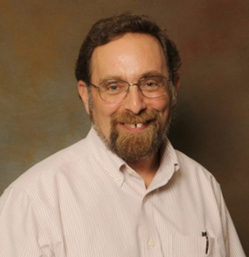
Clemson Approach: Co-oxidation Analysis Using ¹⁴C-TCE
¹⁴C-TCE in Acetonitrile (50 µL)
Exhaust
Hood
FID
N₂
Serum
bottle with GW or FSGW water;
~315 µg/L TCE added along with ~1.1 x 10⁶ dpm ¹⁴C
4-Port
Valve
Packed
Column
Gas Chromatograph

Slide 13
TCE
TCE Epoxide
O
TCE Degradation Products
H
Cl
H
Cl
_
C=C
C
C
Cl
Cl
Cl
Cl
Not Volatile from Alkaline Solution
Volatile

Slide 14
Periodically, a small aliquot (3 mL) is taken from the microcosm containing 100 mL of liquid.
The pH of the aliquot is adjusted with base.
The TCE is purged out of the water with a stream of nitrogen.
Then the remaining ¹⁴C activity is determined using liquid scintillation counting.
The accumulation of ¹⁴C over time is assumed to be degradation products of the TCE.

Slide 15
Performance Assessment: ¹⁴C-TCE Results Tooele Army Depot Well D-20
Production of products from radiolysis of TCE in filter sterilized controls

Slide 17
Meckenstock et al. 2015., ES&T 49: 7073-7081.
Rate constants may not apply at field scale

Slide 18
